Slide 1
mappls
by MapmyIndia
Mobile app user manual
Android and iOS / Release 0.5 / Field and office workflows
Operating procedures and step-by-step use
24 September 2026
Notes:
Mappls Utility Platform release 0.5 pilot. This manual covers implemented software behavior and training examples. Organization-approved physical operating procedures remain separate. Credentials are provided privately. Content source: MapmyIndia repository https://gitlab.mapmyindia.com/rohan/mappls-utility-gis .

Slide 2
Manual contents
Section | Topics | Slides
Access and roles | Sign-in, devices and native screens | 3–8
Field procedures | Preparation, jobs, inspections and readings | 9–28
Evidence recovery | Outbox, offline use, conflicts and handover | 29–40
Connected workflows | Maps, Workspace and utility scenarios | 41–47
Practice and support | Troubleshooting, exercises and shift review | 48–54
Each illustrated procedure is followed by a matching app screen. Use Slide Sorter or the slide numbers to navigate.
Mappls Utility / Mobile manual / 0.5
02
Notes:
Each illustrated procedure is followed by a matching app screen. Use Slide Sorter or the slide numbers to navigate.
Source: mobile/README.md; mobile/ios/MapplsUtility/MapplsUtilityApp.swift; mobile/android/app/src/main/java/com/mappls/utility/MainActivity.java; app/static/utility.js; app/static/guidance.js; app/verticals/api.py; app/mobile.py; docs/mobile-validation.md
Companion: Mappls Utility Web User Manual

Slide 3
Using this manual
All roles
01
Choose your role
Field users capture work and evidence. Engineers investigate. Administrators govern approvals. Viewers review records.
02
Follow the field cycle
Prepare online, verify the equipment, record the work, synchronize and confirm the accepted result.
03
Use the web companion
Workspace opens the ten online modules. Their detailed operating instructions are in the separate Web app user manual.
Screenshots show native iOS. Android follows the same workflow with platform-specific controls.
Mappls Utility / Mobile manual / 0.5
03
Notes:
This manual describes the implemented 0.5 pilot. Button wording follows iOS unless an Android label is stated. Screens and permissions may vary by role. Shared accounts identify a role, not an individual. Use the organization’s approved SOP for physical operations. Credentials are supplied separately from this shareable manual.
Source: mobile/README.md; mobile/ios/MapplsUtility/MapplsUtilityApp.swift; mobile/android/app/src/main/java/com/mappls/utility/MainActivity.java; app/static/utility.js; app/static/guidance.js; app/verticals/api.py; app/mobile.py; docs/mobile-validation.md
Companion: Mappls Utility Web User Manual

Slide 4
Roles and responsibility
Role | Native field work | Online responsibility
Field | Work checks, inspections and readings | Review network context and assigned work
Engineer | Capture evidence and execute work | Edit records, investigate and prepare designs
Administrator | Review or capture field evidence | Approve, commission and govern data
Viewer | Read downloaded assets and work | Review records and export available evidence
Crew search finds jobs. The pilot does not restrict access to an individual crew.
Mappls Utility / Mobile manual / 0.5
04
Notes:
Crew search finds jobs. The pilot does not restrict access to an individual crew.
Source: app/mobile.py; app/verticals/api.py
Companion: Mappls Utility Web User Manual

Slide 5
Native screens and connectivity
Screen | What you do | Connection needed
Work | Find jobs, review checks, queue transitions | Refresh and server acceptance
Assets | Review equipment, inspect and measure | Refresh and online map/trace
Outbox | Review evidence, synchronize, resolve conflicts | Sync and current-record review
Workspace | Use all ten web modules inside the app | Yes
Settings | Check server/role, renew session, sign out | Renewal, refresh and sign-out
Downloaded records and queued capture remain available offline. Mappls basemaps require connectivity.
Mappls Utility / Mobile manual / 0.5
05
Notes:
Downloaded records and queued capture remain available offline. Mappls basemaps require connectivity.
Source: mobile/README.md; mobile/ios/MapplsUtility/MapplsUtilityApp.swift; mobile/android/app/src/main/java/com/mappls/utility/MainActivity.java; app/static/utility.js; app/static/guidance.js; app/verticals/api.py; app/mobile.py; docs/mobile-validation.md
Companion: Mappls Utility Web User Manual

Slide 6
First sign-in
All roles
01
Confirm the service
In Your workspace, enter the supplied server origin. Use the local simulator addresses on the next slide for this evaluation.
02
Choose Role and Password
Select Field, Engineer, Admin or Viewer. Enter that role’s password and tap Sign in.
03
Verify the environment
Check Settings for the server and role. Open Work and confirm a field pack has downloaded.
Check: Work displays the saved pack time/revision and role guidance.
Mappls Utility / Mobile manual / 0.5
06
Notes:
The app does not store the password. It uses a session after successful authentication. A failed sign-in does not establish offline access to a new server. Existing pending evidence must remain with its original server and role.
Source: mobile/README.md; mobile/ios/MapplsUtility/MapplsUtilityApp.swift; mobile/android/app/src/main/java/com/mappls/utility/MainActivity.java; app/static/utility.js; app/static/guidance.js; app/verticals/api.py; app/mobile.py; docs/mobile-validation.md
Companion: Mappls Utility Web User Manual

Slide 7
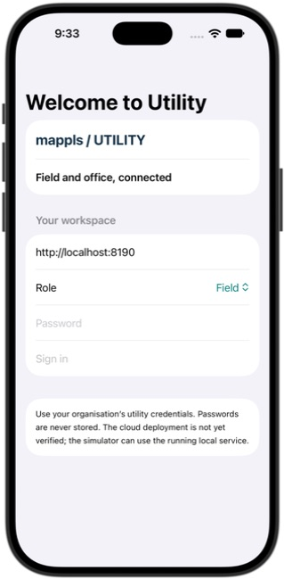
First sign-in on iOS
01
Server address identifies your utility workspace. Local simulator addresses are listed on the next setup slide.
02
Choose the assigned Role and enter the password supplied separately.
03
Select Sign in. Work opens after authentication and the field pack downloads.
iOS native app · release 0.5 · synthetic training data
Mappls Utility / Mobile manual / 0.5
07
Notes:
Actual local application capture on 24 September 2026. iOS UI illustrates shared native workflows; Android uses platform-specific styling. This screenshot follows the matching procedure. Server address identifies your utility workspace. Local simulator addresses are listed on the next setup slide. Choose the assigned Role and enter the password supplied separately. Select Sign in. Work opens after authentication and the field pack downloads.
1. Server address identifies your utility workspace. Local simulator addresses are listed on the next setup slide.
2. Choose the assigned Role and enter the password supplied separately.
3. Select Sign in. Work opens after authentication and the field pack downloads.
Source: mobile/README.md; mobile/ios/MapplsUtility/MapplsUtilityApp.swift; mobile/android/app/src/main/java/com/mappls/utility/MainActivity.java; app/static/utility.js; app/static/guidance.js; app/verticals/api.py; app/mobile.py; docs/mobile-validation.md
Companion: Mappls Utility Web User Manual

Slide 8
Local simulator connection
Client | Server or launch location | Evaluation notes
iOS simulator | http://localhost:8190 | Mac Docker service must be running
Android emulator | http://10.0.2.2:8190 | 10.0.2.2 reaches the Mac host
Xcode 27 preview | Device Hub / Mappls Utility Unit Tests | Select the running simulator in the sidebar
Physical device | Verified HTTPS service supplied by your team | Company signing and device acceptance needed
The proposed public domain is not verified. Local development addresses apply to debug evaluation builds.
Mappls Utility / Mobile manual / 0.5
08
Notes:
The proposed public domain is not verified. Local development addresses apply to debug evaluation builds.
Source: mobile/README.md; docs/mobile-validation.md
Companion: Mappls Utility Web User Manual

Slide 9
Preparation before a field shift
Field / Engineer
01
Refresh while connected
Open Work or Settings and select Refresh field pack. Check the saved time, revision and expected equipment.
02
Confirm the job scope
Filter the utility. Search by work ID or crew. Review the equipment, due date, priority and checklist.
03
Check the device
Confirm battery, local storage, camera/GPS readiness and access to the approved operating procedure.
Check: the correct job and equipment remain readable from the downloaded pack.
Mappls Utility / Mobile manual / 0.5
09
Notes:
A field pack is a complete downloaded snapshot in this pilot. Refresh when the assignment or asset registry changes. A crew search is convenience filtering, not authorization. Agree a fallback communication route with the supervisor before leaving connectivity.
Source: mobile/README.md; mobile/ios/MapplsUtility/MapplsUtilityApp.swift; mobile/android/app/src/main/java/com/mappls/utility/MainActivity.java; app/static/utility.js; app/static/guidance.js; app/verticals/api.py; app/mobile.py; docs/mobile-validation.md
Companion: Mappls Utility Web User Manual

Slide 10
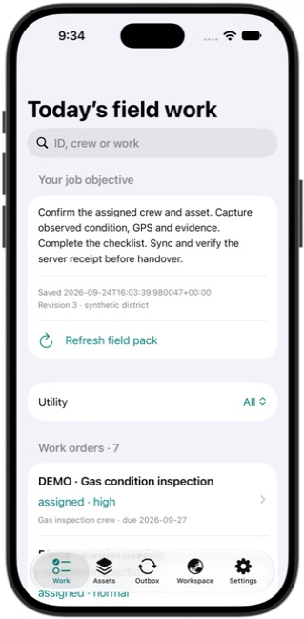
The downloaded field pack
01
Refresh field pack before leaving coverage.
02
Read the saved timestamp and network revision under Your job objective.
03
Use Utility and the search field to find the right job.
iOS native app · release 0.5 · synthetic training data
Mappls Utility / Mobile manual / 0.5
10
Notes:
Actual local application capture on 24 September 2026. iOS UI illustrates shared native workflows; Android uses platform-specific styling. This screenshot follows the matching procedure. Refresh field pack before leaving coverage. Read the saved timestamp and network revision under Your job objective. Use Utility and the search field to find the right job.
1. Refresh field pack before leaving coverage.
2. Read the saved timestamp and network revision under Your job objective.
3. Use Utility and the search field to find the right job.
Source: mobile/README.md; mobile/ios/MapplsUtility/MapplsUtilityApp.swift; mobile/android/app/src/main/java/com/mappls/utility/MainActivity.java; app/static/utility.js; app/static/guidance.js; app/verticals/api.py; app/mobile.py; docs/mobile-validation.md
Companion: Mappls Utility Web User Manual

Slide 11
Work list and job selection
Field / Engineer / Administrator
01
Find the job
Open Work. Select a utility or All, then search by ID, crew or work description.
02
Read the assignment
Open the work order. Compare its crew, due date, priority and status with the supervisor’s assignment.
03
Verify equipment
Use Equipment & inspection to open the linked asset. Match its ID and name to the actual equipment.
Outcome: one confirmed work order and one confirmed asset.
Mappls Utility / Mobile manual / 0.5
11
Notes:
If no jobs appear, clear search and utility filters, then refresh online. A missing assignment needs the office owner to create or correct it in web Field operations.
Source: mobile/README.md; mobile/ios/MapplsUtility/MapplsUtilityApp.swift; mobile/android/app/src/main/java/com/mappls/utility/MainActivity.java; app/static/utility.js; app/static/guidance.js; app/verticals/api.py; app/mobile.py; docs/mobile-validation.md
Companion: Mappls Utility Web User Manual

Slide 12
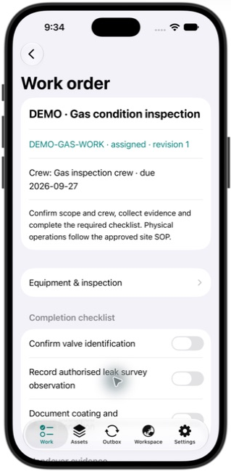
A selected work order
01
Check the job title, crew and due date.
02
Equipment & inspection opens the associated equipment record.
03
Review the completion checklist before starting. Scroll down for the work action.
iOS native app · release 0.5 · synthetic training data
Mappls Utility / Mobile manual / 0.5
12
Notes:
Actual local application capture on 24 September 2026. iOS UI illustrates shared native workflows; Android uses platform-specific styling. This screenshot follows the matching procedure. Check the job title, crew and due date. Equipment & inspection opens the associated equipment record. Review the completion checklist before starting. Scroll down for the work action.
1. Check the job title, crew and due date.
2. Equipment & inspection opens the associated equipment record.
3. Review the completion checklist before starting. Scroll down for the work action.
Source: mobile/README.md; mobile/ios/MapplsUtility/MapplsUtilityApp.swift; mobile/android/app/src/main/java/com/mappls/utility/MainActivity.java; app/static/utility.js; app/static/guidance.js; app/verticals/api.py; app/mobile.py; docs/mobile-validation.md
Companion: Mappls Utility Web User Manual

Slide 13
Starting assigned work
Field / Engineer / Administrator
01
Review the checklist
Read all required checks and the job scope. Confirm site authorization through your normal process.
02
Queue the transition
Tap Queue start work. The app stores a pending transition in its encrypted outbox.
03
Synchronize the start
Open Outbox, tap Sync queued work, then refresh and confirm the job is In progress.
Check: synchronize the start before queueing completion.
Mappls Utility / Mobile manual / 0.5
13
Notes:
A pending transition prevents another transition on the same job. Without connectivity, capture other permitted evidence but retain the pending start. Queueing a transition does not itself change the shared work state.
Source: mobile/README.md; mobile/ios/MapplsUtility/MapplsUtilityApp.swift; mobile/android/app/src/main/java/com/mappls/utility/MainActivity.java; app/static/utility.js; app/static/guidance.js; app/verticals/api.py; app/mobile.py; docs/mobile-validation.md
Companion: Mappls Utility Web User Manual

Slide 14
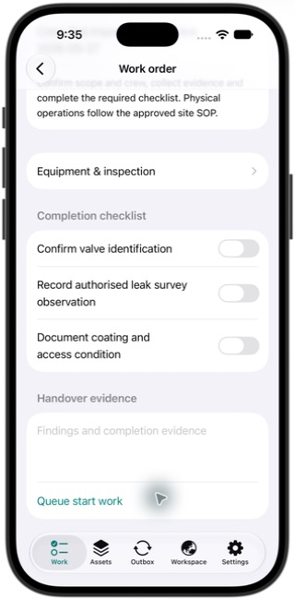
Starting work from the phone
01
The assigned job exposes Queue start work below Handover evidence.
02
Select Queue start work, then open Outbox.
03
Sync before queuing another transition on this job. The next revision comes from the server.
iOS native app · release 0.5 · synthetic training data
Mappls Utility / Mobile manual / 0.5
14
Notes:
Actual local application capture on 24 September 2026. iOS UI illustrates shared native workflows; Android uses platform-specific styling. This screenshot follows the matching procedure. The assigned job exposes Queue start work below Handover evidence. Select Queue start work, then open Outbox. Sync before queuing another transition on this job. The next revision comes from the server.
1. The assigned job exposes Queue start work below Handover evidence.
2. Select Queue start work, then open Outbox.
3. Sync before queuing another transition on this job. The next revision comes from the server.
Source: mobile/README.md; mobile/ios/MapplsUtility/MapplsUtilityApp.swift; mobile/android/app/src/main/java/com/mappls/utility/MainActivity.java; app/static/utility.js; app/static/guidance.js; app/verticals/api.py; app/mobile.py; docs/mobile-validation.md
Companion: Mappls Utility Web User Manual

Slide 15
Asset lookup and revision
All roles
01
Find equipment
Open Assets. Filter the utility and search by ID, equipment name or zone.
02
Review its record
Open the asset. Read the equipment ID, utility, class, attributes and record revision.
03
Choose the next action
Use Capture inspection or Record measurement for field evidence. Map and trace actions open the online Workspace.
Outcome: evidence relates to the correct equipment and captured revision.
Mappls Utility / Mobile manual / 0.5
15
Notes:
Viewer sees records but cannot capture evidence. An asset coordinate is a registry location. It does not establish surveyed underground position or clearance.
Source: mobile/README.md; mobile/ios/MapplsUtility/MapplsUtilityApp.swift; mobile/android/app/src/main/java/com/mappls/utility/MainActivity.java; app/static/utility.js; app/static/guidance.js; app/verticals/api.py; app/mobile.py; docs/mobile-validation.md
Companion: Mappls Utility Web User Manual

Slide 16
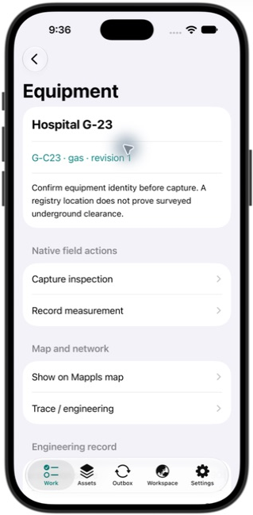
Equipment identity and actions
01
Confirm G-C23, the utility and record revision in this example.
02
Capture inspection records condition and evidence. Record measurement opens a typed reading form.
03
Map and engineering actions open the connected Workspace.
iOS native app · release 0.5 · synthetic training data
Mappls Utility / Mobile manual / 0.5
16
Notes:
Actual local application capture on 24 September 2026. iOS UI illustrates shared native workflows; Android uses platform-specific styling. This screenshot follows the matching procedure. Confirm G-C23, the utility and record revision in this example. Capture inspection records condition and evidence. Record measurement opens a typed reading form. Map and engineering actions open the connected Workspace.
1. Confirm G-C23, the utility and record revision in this example.
2. Capture inspection records condition and evidence. Record measurement opens a typed reading form.
3. Map and engineering actions open the connected Workspace.
Source: mobile/README.md; mobile/ios/MapplsUtility/MapplsUtilityApp.swift; mobile/android/app/src/main/java/com/mappls/utility/MainActivity.java; app/static/utility.js; app/static/guidance.js; app/verticals/api.py; app/mobile.py; docs/mobile-validation.md
Companion: Mappls Utility Web User Manual

Slide 17
Condition inspection
Field / Engineer / Administrator
01
Open Capture inspection
From the asset, choose the observed condition: Good, Attention or Critical.
02
Describe the finding
Enter Findings and follow-up. State what was observed, where it occurred and what follow-up is needed.
03
Save the evidence
Optionally attach permitted GPS/photo evidence. Tap Save encrypted inspection and open Outbox.
Check: a pending inspection appears with the correct asset ID.
Mappls Utility / Mobile manual / 0.5
17
Notes:
Notes need at least three characters and are limited to 3,000 characters. Use useful evidence rather than a minimum-length placeholder. An iOS inspection draft retains condition, notes, photo and the captured revision. Queued evidence still requires successful synchronization.
Source: mobile/README.md; mobile/ios/MapplsUtility/MapplsUtilityApp.swift; mobile/android/app/src/main/java/com/mappls/utility/MainActivity.java; app/static/utility.js; app/static/guidance.js; app/verticals/api.py; app/mobile.py; docs/mobile-validation.md
Companion: Mappls Utility Web User Manual

Slide 18
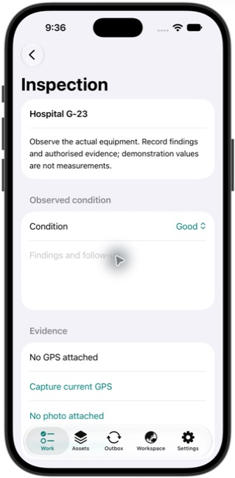
Condition and findings
01
Choose the observed Condition.
02
Enter findings and follow-up in the text area.
03
Scroll to Evidence and Save encrypted inspection. Saving locally does not synchronize the record.
iOS native app · release 0.5 · synthetic training data
Mappls Utility / Mobile manual / 0.5
18
Notes:
Actual local application capture on 24 September 2026. iOS UI illustrates shared native workflows; Android uses platform-specific styling. This screenshot follows the matching procedure. Choose the observed Condition. Enter findings and follow-up in the text area. Scroll to Evidence and Save encrypted inspection. Saving locally does not synchronize the record.
1. Choose the observed Condition.
2. Enter findings and follow-up in the text area.
3. Scroll to Evidence and Save encrypted inspection. Saving locally does not synchronize the record.
Source: mobile/README.md; mobile/ios/MapplsUtility/MapplsUtilityApp.swift; mobile/android/app/src/main/java/com/mappls/utility/MainActivity.java; app/static/utility.js; app/static/guidance.js; app/verticals/api.py; app/mobile.py; docs/mobile-validation.md
Companion: Mappls Utility Web User Manual

Slide 19
GPS evidence
Field / Engineer / Administrator
01
Request a fresh fix
Inside the inspection, tap Capture current GPS. Respond to the device’s location permission request.
02
Check accuracy
Read the reported capture status and accuracy. Note obstructions or uncertainty in the findings.
03
Retain the context
Save the inspection with the fix only when it represents the inspected equipment.
Outcome: the inspection can include coordinates and horizontal accuracy.
Mappls Utility / Mobile manual / 0.5
19
Notes:
GPS runs in the foreground on request. The app does not continuously track crews. A simulator location can be synthetic. Use a physical device to accept the real GPS workflow and permission-denial behavior.
Source: mobile/README.md; mobile/ios/MapplsUtility/MapplsUtilityApp.swift; mobile/android/app/src/main/java/com/mappls/utility/MainActivity.java; app/static/utility.js; app/static/guidance.js; app/verticals/api.py; app/mobile.py; docs/mobile-validation.md
Companion: Mappls Utility Web User Manual

Slide 20
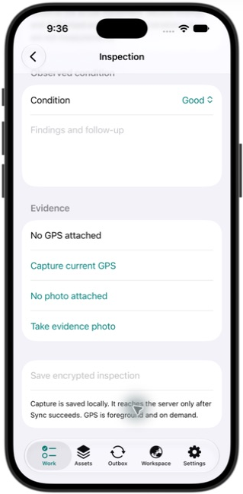
Location evidence controls
01
Capture current GPS requests the device position when selected.
02
Review the location and accuracy returned by the device before saving.
03
This simulator capture shows No GPS attached. It is not a real site position.
iOS native app · release 0.5 · synthetic training data
Mappls Utility / Mobile manual / 0.5
20
Notes:
Actual local application capture on 24 September 2026. iOS UI illustrates shared native workflows; Android uses platform-specific styling. This screenshot follows the matching procedure. Capture current GPS requests the device position when selected. Review the location and accuracy returned by the device before saving. This simulator capture shows No GPS attached. It is not a real site position.
1. Capture current GPS requests the device position when selected.
2. Review the location and accuracy returned by the device before saving.
3. This simulator capture shows No GPS attached. It is not a real site position.
Source: mobile/README.md; mobile/ios/MapplsUtility/MapplsUtilityApp.swift; mobile/android/app/src/main/java/com/mappls/utility/MainActivity.java; app/static/utility.js; app/static/guidance.js; app/verticals/api.py; app/mobile.py; docs/mobile-validation.md
Companion: Mappls Utility Web User Manual

Slide 21
Photo evidence
Field / Engineer / Administrator
01
Capture an appropriate view
Tap Take evidence photo in the inspection. Include the equipment identity and visible finding when permitted.
02
Check attachment status
Return to the inspection and confirm that a JPEG photo is attached before saving.
03
Save and synchronize
Save encrypted inspection, then synchronize and verify acceptance in Outbox.
Check: photos are re-encoded with a one-megabyte evidence limit.
Mappls Utility / Mobile manual / 0.5
21
Notes:
The iOS simulator has no camera capture. Test on an iPhone for real evidence. Android uses the native camera workflow. Retake an oversized or unclear image. Follow the organization’s rules about people and sensitive site details in photographs.
Source: mobile/README.md; mobile/ios/MapplsUtility/MapplsUtilityApp.swift; mobile/android/app/src/main/java/com/mappls/utility/MainActivity.java; app/static/utility.js; app/static/guidance.js; app/verticals/api.py; app/mobile.py; docs/mobile-validation.md
Companion: Mappls Utility Web User Manual

Slide 22
Photo evidence controls
01
Take evidence photo opens the device camera on supported hardware.
02
Review the attached photo before Save encrypted inspection.
03
The simulator example shows No photo attached. Use a physical device for the camera exercise.
iOS native app · release 0.5 · synthetic training data
Mappls Utility / Mobile manual / 0.5
22
Notes:
Actual local application capture on 24 September 2026. iOS UI illustrates shared native workflows; Android uses platform-specific styling. This screenshot follows the matching procedure. Take evidence photo opens the device camera on supported hardware. Review the attached photo before Save encrypted inspection. The simulator example shows No photo attached. Use a physical device for the camera exercise.
1. Take evidence photo opens the device camera on supported hardware.
2. Review the attached photo before Save encrypted inspection.
3. The simulator example shows No photo attached. Use a physical device for the camera exercise.
Source: mobile/README.md; mobile/ios/MapplsUtility/MapplsUtilityApp.swift; mobile/android/app/src/main/java/com/mappls/utility/MainActivity.java; app/static/utility.js; app/static/guidance.js; app/verticals/api.py; app/mobile.py; docs/mobile-validation.md
Companion: Mappls Utility Web User Manual

Slide 23
Utility measurement capture
Field / Engineer / Administrator
01
Choose Record measurement
Open the correct asset and select a metric available for its utility.
02
Read the unit and range
Enter the actual measured value. Add instrument, method and operating context.
03
Save the reading
Tap Save encrypted reading. The app records the observation time and queues the value.
Check: synchronize and review the observation in the shared Workspace.
Mappls Utility / Mobile manual / 0.5
23
Notes:
A finite number within the configured input range is required. Input ranges are validation limits, not safe operating limits. Native capture timestamps the reading when saved. Use the web observation form when an explicitly selected observation time is needed.
Source: mobile/README.md; mobile/ios/MapplsUtility/MapplsUtilityApp.swift; mobile/android/app/src/main/java/com/mappls/utility/MainActivity.java; app/static/utility.js; app/static/guidance.js; app/verticals/api.py; app/mobile.py; docs/mobile-validation.md
Companion: Mappls Utility Web User Manual

Slide 24
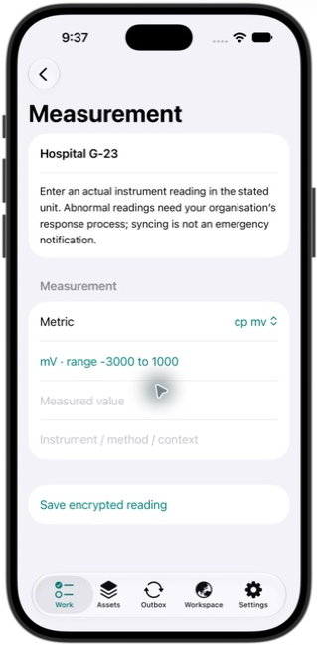
A utility-specific reading
01
Metric selects the measurement. This gas example displays cp mv.
02
The form shows mV and the permitted entry range. Enter the measured value with its context.
03
Save encrypted reading adds it to Outbox. It does not send an emergency notification.
iOS native app · release 0.5 · synthetic training data
Mappls Utility / Mobile manual / 0.5
24
Notes:
Actual local application capture on 24 September 2026. iOS UI illustrates shared native workflows; Android uses platform-specific styling. This screenshot follows the matching procedure. Metric selects the measurement. This gas example displays cp mv. The form shows mV and the permitted entry range. Enter the measured value with its context. Save encrypted reading adds it to Outbox. It does not send an emergency notification.
1. Metric selects the measurement. This gas example displays cp mv.
2. The form shows mV and the permitted entry range. Enter the measured value with its context.
3. Save encrypted reading adds it to Outbox. It does not send an emergency notification.
Source: mobile/README.md; mobile/ios/MapplsUtility/MapplsUtilityApp.swift; mobile/android/app/src/main/java/com/mappls/utility/MainActivity.java; app/static/utility.js; app/static/guidance.js; app/verticals/api.py; app/mobile.py; docs/mobile-validation.md
Companion: Mappls Utility Web User Manual

Slide 25
Measurement units by utility
Utility | Available measurements | Field context
Power | Voltage kV / current A / energy kWh | Equipment, phase and instrument
Water | Head m / volume m³ / chlorine mg/L | DMA, sample point and period
Gas | Pressure bar(g) / leak ppm / CP mV | Location, instrument and MAOP context
Telecom | Receive dBm / loss dB / latency ms | Endpoints, fibre and test setup
A review flag needs follow-up. Sync is not an emergency notification.
Mappls Utility / Mobile manual / 0.5
25
Notes:
A review flag needs follow-up. Sync is not an emergency notification.
Source: app/verticals/api.py:METRICS
Companion: Mappls Utility Web User Manual

Slide 26
Collection and heating measurements
Utility | Available measurements | Field context
Wastewater | Level m / flow L/s | Manhole, receiving works and flow direction
Stormwater | Rainfall mm/h / level m | Catchment, observation time and outfall
District heating | Temperature °C / energy kWh | Supply/return context and accounting period
Use the metric exactly as displayed. Explain whether a temperature is supply or return in the note.
Mappls Utility / Mobile manual / 0.5
26
Notes:
Use the metric exactly as displayed. Explain whether a temperature is supply or return in the note.
Source: app/verticals/api.py:METRICS
Companion: Mappls Utility Web User Manual

Slide 27
Completing a work order
Field / Engineer / Administrator
01
Confirm In progress
Refresh the job after its start transition has synchronized. Review the current work revision.
02
Complete the evidence
Mark every required checklist item and enter Findings and completion evidence.
03
Queue and confirm completion
Tap Queue completion. Sync in Outbox, then refresh and confirm Completed in the shared work record.
Check: all checklist items and at least ten characters of completion evidence are required.
Mappls Utility / Mobile manual / 0.5
27
Notes:
A checkbox records the user’s assertion that the corresponding work was completed. It does not operate equipment. If the work cannot be completed, keep its status accurate and contact the assignment owner.
Source: mobile/README.md; mobile/ios/MapplsUtility/MapplsUtilityApp.swift; mobile/android/app/src/main/java/com/mappls/utility/MainActivity.java; app/static/utility.js; app/static/guidance.js; app/verticals/api.py; app/mobile.py; docs/mobile-validation.md
Companion: Mappls Utility Web User Manual

Slide 28
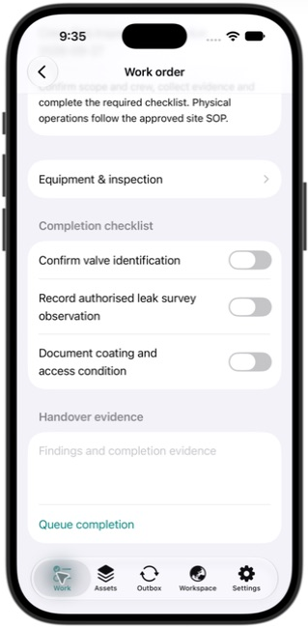
Completion checks and handover
01
After the start receipt, the checklist becomes editable.
02
Complete every required check and record findings in Handover evidence.
03
Queue completion, then synchronize and verify the server receipt. This screen shows the action before submission.
iOS native app · release 0.5 · synthetic training data
Mappls Utility / Mobile manual / 0.5
28
Notes:
Actual local application capture on 24 September 2026. iOS UI illustrates shared native workflows; Android uses platform-specific styling. This screenshot follows the matching procedure. After the start receipt, the checklist becomes editable. Complete every required check and record findings in Handover evidence. Queue completion, then synchronize and verify the server receipt. This screen shows the action before submission.
1. After the start receipt, the checklist becomes editable.
2. Complete every required check and record findings in Handover evidence.
3. Queue completion, then synchronize and verify the server receipt. This screen shows the action before submission.
Source: mobile/README.md; mobile/ios/MapplsUtility/MapplsUtilityApp.swift; mobile/android/app/src/main/java/com/mappls/utility/MainActivity.java; app/static/utility.js; app/static/guidance.js; app/verticals/api.py; app/mobile.py; docs/mobile-validation.md
Companion: Mappls Utility Web User Manual

Slide 29
Outbox and server receipts
All capturing roles
01
Review pending evidence
Open Outbox. Inspect each label, status and error, and confirm the pending count.
02
Run foreground sync
Reconnect, keep the app open and tap Sync queued work. Renew sign-in if the session expired.
03
Confirm acceptance
Read Server receipts and verify the resulting record or work state after refresh.
Outcome: each accepted item has a receipt. Failed items remain available for review.
Mappls Utility / Mobile manual / 0.5
29
Notes:
The queue holds at most 100 entries. Sync regularly instead of waiting until it is full. Receipt lists show recent acknowledgements. Use the authoritative web registers for continuing history.
Source: mobile/README.md; mobile/ios/MapplsUtility/MapplsUtilityApp.swift; mobile/android/app/src/main/java/com/mappls/utility/MainActivity.java; app/static/utility.js; app/static/guidance.js; app/verticals/api.py; app/mobile.py; docs/mobile-validation.md
Companion: Mappls Utility Web User Manual

Slide 30
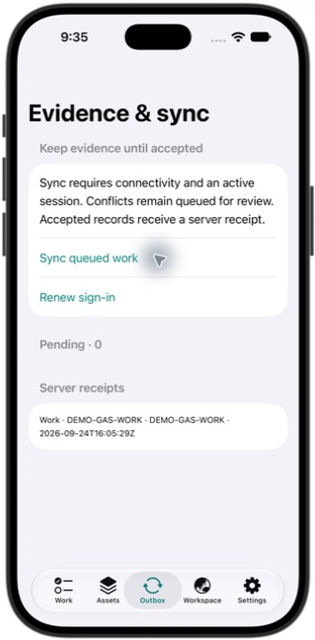
An accepted server receipt
01
Sync queued work sends the foreground queue.
02
Pending is now 0 after the demo work-start operation was accepted.
03
Server receipts identifies DEMO-GAS-WORK and the acceptance time. Match it to the intended job.
iOS native app · release 0.5 · synthetic training data
Mappls Utility / Mobile manual / 0.5
30
Notes:
Actual local application capture on 24 September 2026. iOS UI illustrates shared native workflows; Android uses platform-specific styling. This screenshot follows the matching procedure. Sync queued work sends the foreground queue. Pending is now 0 after the demo work-start operation was accepted. Server receipts identifies DEMO-GAS-WORK and the acceptance time. Match it to the intended job.
1. Sync queued work sends the foreground queue.
2. Pending is now 0 after the demo work-start operation was accepted.
3. Server receipts identifies DEMO-GAS-WORK and the acceptance time. Match it to the intended job.
Source: mobile/README.md; mobile/ios/MapplsUtility/MapplsUtilityApp.swift; mobile/android/app/src/main/java/com/mappls/utility/MainActivity.java; app/static/utility.js; app/static/guidance.js; app/verticals/api.py; app/mobile.py; docs/mobile-validation.md
Companion: Mappls Utility Web User Manual

Slide 31
Offline capture and safe retries
All capturing roles
01
Keep the downloaded pack
Use saved Work and Assets when offline. Mappls maps and server calculations need a connection.
02
Retain unsent records
Keep the app installed and its device data intact while any evidence is pending.
03
Retry after reconnecting
Use Sync queued work again. Existing record identifiers support safe replay of the same submission.
Check: a local save means queued evidence. A server receipt means acceptance.
Mappls Utility / Mobile manual / 0.5
31
Notes:
No background synchronization or push dispatch is implemented in 0.5. Avoid recreating a failed record as a new record before reviewing the queue. Encryption protects local storage but is not a remote-wipe service.
Source: mobile/README.md; mobile/ios/MapplsUtility/MapplsUtilityApp.swift; mobile/android/app/src/main/java/com/mappls/utility/MainActivity.java; app/static/utility.js; app/static/guidance.js; app/verticals/api.py; app/mobile.py; docs/mobile-validation.md
Companion: Mappls Utility Web User Manual

Slide 32
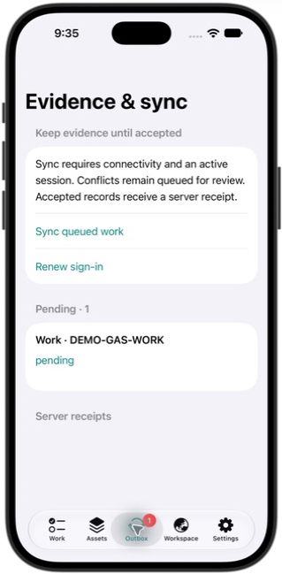
Pending evidence on the device
01
The example has one pending work transition.
02
Keep the record while connectivity is unavailable. Sync queued work retries when online.
03
Check Server receipts after acceptance. Avoid entering the same work again manually.
iOS native app · release 0.5 · synthetic training data
Mappls Utility / Mobile manual / 0.5
32
Notes:
Actual local application capture on 24 September 2026. iOS UI illustrates shared native workflows; Android uses platform-specific styling. This screenshot follows the matching procedure. The example has one pending work transition. Keep the record while connectivity is unavailable. Sync queued work retries when online. Check Server receipts after acceptance. Avoid entering the same work again manually.
1. The example has one pending work transition.
2. Keep the record while connectivity is unavailable. Sync queued work retries when online.
3. Check Server receipts after acceptance. Avoid entering the same work again manually.
Source: mobile/README.md; mobile/ios/MapplsUtility/MapplsUtilityApp.swift; mobile/android/app/src/main/java/com/mappls/utility/MainActivity.java; app/static/utility.js; app/static/guidance.js; app/verticals/api.py; app/mobile.py; docs/mobile-validation.md
Companion: Mappls Utility Web User Manual

Slide 33
Inspection revision conflict
All capturing roles
01
Open Review queued record
Read the error. The original inspection and captured revision remain in the queue.
02
Compare the current asset
Refresh current record and compare the changed equipment details with the original field finding.
03
Confirm only after review
Use I reviewed this asset — retry at current revision when the evidence still applies. Sync and check the receipt.
Outcome: explicit reconciliation preserves the original evidence and capture time.
Mappls Utility / Mobile manual / 0.5
33
Notes:
Android performs current-record refresh as part of its review flow and asks for reconciliation confirmation. If an equipment change invalidates the evidence, arrange a new inspection. Do not rebase blindly.
Source: mobile/README.md; mobile/ios/MapplsUtility/MapplsUtilityApp.swift; mobile/android/app/src/main/java/com/mappls/utility/MainActivity.java; app/static/utility.js; app/static/guidance.js; app/verticals/api.py; app/mobile.py; docs/mobile-validation.md
Companion: Mappls Utility Web User Manual

Slide 34
Where an inspection conflict is reviewed
01
Outbox is the place to find retained records. This screenshot shows a pending example.
02
A conflicting inspection displays its conflict state and review action after a rejected sync.
03
Follow the previous slide to compare the refreshed revision. A conflict is not shown in this screenshot.
iOS native app · release 0.5 · synthetic training data
Mappls Utility / Mobile manual / 0.5
34
Notes:
Actual local application capture on 24 September 2026. iOS UI illustrates shared native workflows; Android uses platform-specific styling. This screenshot follows the matching procedure. Outbox is the place to find retained records. This screenshot shows a pending example. A conflicting inspection displays its conflict state and review action after a rejected sync. Follow the previous slide to compare the refreshed revision. A conflict is not shown in this screenshot.
1. Outbox is the place to find retained records. This screenshot shows a pending example.
2. A conflicting inspection displays its conflict state and review action after a rejected sync.
3. Follow the previous slide to compare the refreshed revision. A conflict is not shown in this screenshot.
Source: mobile/README.md; mobile/ios/MapplsUtility/MapplsUtilityApp.swift; mobile/android/app/src/main/java/com/mappls/utility/MainActivity.java; app/static/utility.js; app/static/guidance.js; app/verticals/api.py; app/mobile.py; docs/mobile-validation.md
Companion: Mappls Utility Web User Manual

Slide 35
Work or reading conflict
All capturing roles
01
Read the queued error
Open Review queued record. Identify the work order or measurement concerned.
02
Check the authoritative state
Open Workspace for review. Compare current work status, revision and existing observations.
03
Reconcile the outcome
Coordinate with the owner. Discard the unsent item only after recording the correct outcome elsewhere.
Check: the app does not automatically overwrite changed work records.
Mappls Utility / Mobile manual / 0.5
35
Notes:
Discard removes unsent evidence. Preserve required evidence and document the reconciliation before using it. If the correct resolution is unclear, leave the item queued and escalate with the record ID and error text.
Source: mobile/README.md; mobile/ios/MapplsUtility/MapplsUtilityApp.swift; mobile/android/app/src/main/java/com/mappls/utility/MainActivity.java; app/static/utility.js; app/static/guidance.js; app/verticals/api.py; app/mobile.py; docs/mobile-validation.md
Companion: Mappls Utility Web User Manual

Slide 36
Where work and reading retries remain
01
Pending operations stay in Outbox until accepted or explicitly reconciled.
02
Work conflicts require the current checklist and revision. Reading retries keep their operation identity.
03
This is the normal pending view. Conditional conflict controls appear only after a conflict response.
iOS native app · release 0.5 · synthetic training data
Mappls Utility / Mobile manual / 0.5
36
Notes:
Actual local application capture on 24 September 2026. iOS UI illustrates shared native workflows; Android uses platform-specific styling. This screenshot follows the matching procedure. Pending operations stay in Outbox until accepted or explicitly reconciled. Work conflicts require the current checklist and revision. Reading retries keep their operation identity. This is the normal pending view. Conditional conflict controls appear only after a conflict response.
1. Pending operations stay in Outbox until accepted or explicitly reconciled.
2. Work conflicts require the current checklist and revision. Reading retries keep their operation identity.
3. This is the normal pending view. Conditional conflict controls appear only after a conflict response.
Source: mobile/README.md; mobile/ios/MapplsUtility/MapplsUtilityApp.swift; mobile/android/app/src/main/java/com/mappls/utility/MainActivity.java; app/static/utility.js; app/static/guidance.js; app/verticals/api.py; app/mobile.py; docs/mobile-validation.md
Companion: Mappls Utility Web User Manual

Slide 37
Session renewal and Settings
All roles
01
Verify the destination
Open Settings and check Connected environment, role and release.
02
Renew at the same role/server
Use Renew sign-in and enter the current password. Pending evidence stays with its original environment.
03
Refresh after renewal
Return to the saved field pack, refresh online, then synchronize outstanding work.
Check: resolve the queue before changing server or role.
Mappls Utility / Mobile manual / 0.5
37
Notes:
Sessions expire after eight hours. Password rotation invalidates existing mobile sessions. Expiry prevents server access but does not remotely erase an offline pack. The application blocks switching environment while records remain queued.
Source: mobile/README.md; mobile/ios/MapplsUtility/MapplsUtilityApp.swift; mobile/android/app/src/main/java/com/mappls/utility/MainActivity.java; app/static/utility.js; app/static/guidance.js; app/verticals/api.py; app/mobile.py; docs/mobile-validation.md
Companion: Mappls Utility Web User Manual

Slide 38
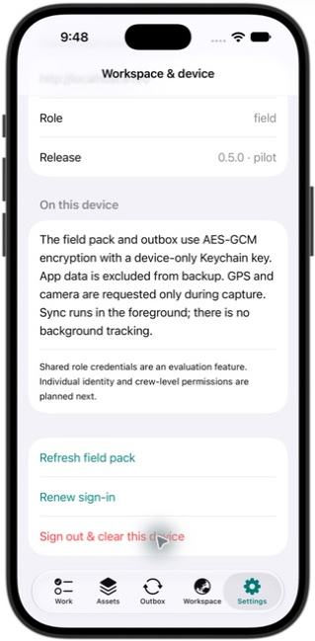
Account and field-pack maintenance
01
Confirm the role and release. Scroll up to Connected environment to check the server.
02
Refresh field pack downloads current records.
03
Renew sign-in restores the session for the same role and server without discarding queued work.
iOS native app · release 0.5 · synthetic training data
Mappls Utility / Mobile manual / 0.5
38
Notes:
Actual local application capture on 24 September 2026. iOS UI illustrates shared native workflows; Android uses platform-specific styling. This screenshot follows the matching procedure. Connected environment identifies the server and role. Refresh field pack downloads current records. Renew sign-in restores the session for the same role and server without discarding queued work.
1. Confirm the role and release. Scroll up to Connected environment to check the server.
2. Refresh field pack downloads current records.
3. Renew sign-in restores the session for the same role and server without discarding queued work.
Source: mobile/README.md; mobile/ios/MapplsUtility/MapplsUtilityApp.swift; mobile/android/app/src/main/java/com/mappls/utility/MainActivity.java; app/static/utility.js; app/static/guidance.js; app/verticals/api.py; app/mobile.py; docs/mobile-validation.md
Companion: Mappls Utility Web User Manual

Slide 39
Device handover and sign-out
All roles
01
Reconcile the outbox
Ensure every required item is accepted or deliberately resolved before ending the shift.
02
Check the shared result
Confirm completed work and accepted evidence with the office owner.
03
Clear the device when appropriate
In Settings, use Sign out & clear this device and confirm only after checking drafts and pending work.
Outcome: a reconciled handover before downloaded data and drafts are cleared.
Mappls Utility / Mobile manual / 0.5
39
Notes:
Sign-out is blocked while queued evidence remains. Android uses Keystore-backed encryption and iOS uses device-only Keychain-backed encryption. Managed-device rollout, remote wipe and biometric app locking remain outside this pilot.
Source: mobile/README.md; mobile/ios/MapplsUtility/MapplsUtilityApp.swift; mobile/android/app/src/main/java/com/mappls/utility/MainActivity.java; app/static/utility.js; app/static/guidance.js; app/verticals/api.py; app/mobile.py; docs/mobile-validation.md
Companion: Mappls Utility Web User Manual

Slide 40
Device handover controls
01
Review and synchronize Outbox first.
02
Sign out & clear this device removes downloaded data after the confirmation and successful sign-out.
03
The app blocks sign-out while pending operations remain. This screen shows the control before confirmation.
iOS native app · release 0.5 · synthetic training data
Mappls Utility / Mobile manual / 0.5
40
Notes:
Actual local application capture on 24 September 2026. iOS UI illustrates shared native workflows; Android uses platform-specific styling. This screenshot follows the matching procedure. Review and synchronize Outbox first. Sign out & clear this device removes downloaded data after the confirmation and successful sign-out. The app blocks sign-out while pending operations remain. This screen shows the control before confirmation.
1. Review and synchronize Outbox first.
2. Sign out & clear this device removes downloaded data after the confirmation and successful sign-out.
3. The app blocks sign-out while pending operations remain. This screen shows the control before confirmation.
Source: mobile/README.md; mobile/ios/MapplsUtility/MapplsUtilityApp.swift; mobile/android/app/src/main/java/com/mappls/utility/MainActivity.java; app/static/utility.js; app/static/guidance.js; app/verticals/api.py; app/mobile.py; docs/mobile-validation.md
Companion: Mappls Utility Web User Manual

Slide 41
Maps and engineering inside the app
All roles
01
Open the asset context
From Assets, select Show on Mappls map or Trace / engineering.
02
Review online results
Check the selected equipment, utility and current network revision in the embedded Workspace.
03
Return to native capture
Use native Assets for inspections and readings. Use Work for local checklists and queued transitions.
Check: the online Workspace and native field pack can reflect different refresh times.
Mappls Utility / Mobile manual / 0.5
41
Notes:
Workspace is an integrated web experience, not a second offline map engine. Mappls tiles are not cached. All ten modules retain their role restrictions. An expired handoff can be retried by reopening the module.
Source: mobile/README.md; mobile/ios/MapplsUtility/MapplsUtilityApp.swift; mobile/android/app/src/main/java/com/mappls/utility/MainActivity.java; app/static/utility.js; app/static/guidance.js; app/verticals/api.py; app/mobile.py; docs/mobile-validation.md
Companion: Mappls Utility Web User Manual

Slide 42
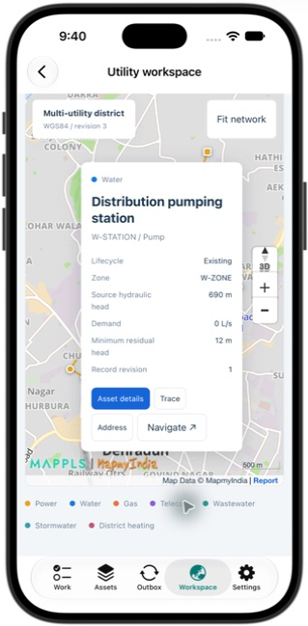
Mappls inside the native app
01
Workspace opens the current network in an embedded online view.
02
The selected asset card links to details, Trace, Address and Navigate.
03
The native tabs remain available below. Map tiles and engineering require connectivity.
iOS native app · release 0.5 · synthetic training data
Mappls Utility / Mobile manual / 0.5
42
Notes:
Actual local application capture on 24 September 2026. iOS UI illustrates shared native workflows; Android uses platform-specific styling. This screenshot follows the matching procedure. Workspace opens the current network in an embedded online view. The selected asset card links to details, Trace, Address and Navigate. The native tabs remain available below. Map tiles and engineering require connectivity.
1. Workspace opens the current network in an embedded online view.
2. The selected asset card links to details, Trace, Address and Navigate.
3. The native tabs remain available below. Map tiles and engineering require connectivity.
Source: mobile/README.md; mobile/ios/MapplsUtility/MapplsUtilityApp.swift; mobile/android/app/src/main/java/com/mappls/utility/MainActivity.java; app/static/utility.js; app/static/guidance.js; app/verticals/api.py; app/mobile.py; docs/mobile-validation.md
Companion: Mappls Utility Web User Manual

Slide 43
Workspace module directory
Office objective | Modules in the app | Manual reference
Understand the network | District overview / Network explorer | Web manual: network baseline
Investigate service | Engineering / Incidents / Fibre | Web manual: analysis and response
Plan and execute | Design & quantities / Field operations | Web manual: design and work
Maintain evidence | Observations / Excavation / Data | Web manual: evidence and governance
The module list is online. Native Work and Assets provide the downloaded field context.
Mappls Utility / Mobile manual / 0.5
43
Notes:
The module list is online. Native Work and Assets provide the downloaded field context.
Source: mobile/README.md; mobile/ios/MapplsUtility/MapplsUtilityApp.swift; mobile/android/app/src/main/java/com/mappls/utility/MainActivity.java; app/static/utility.js; app/static/guidance.js; app/verticals/api.py; app/mobile.py; docs/mobile-validation.md
Companion: Mappls Utility Web User Manual

Slide 44
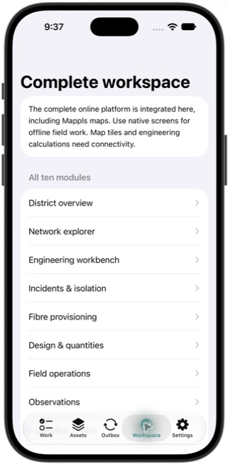
The complete online module menu
01
Select any of the ten modules from Workspace.
02
The app passes your authenticated role into the connected web workspace.
03
Use the separate Web manual for each online module; use native Work and Assets for offline field capture.
iOS native app · release 0.5 · synthetic training data
Mappls Utility / Mobile manual / 0.5
44
Notes:
Actual local application capture on 24 September 2026. iOS UI illustrates shared native workflows; Android uses platform-specific styling. This screenshot follows the matching procedure. Select any of the ten modules from Workspace. The app passes your authenticated role into the connected web workspace. Use the separate Web manual for each online module; use native Work and Assets for offline field capture.
1. Select any of the ten modules from Workspace.
2. The app passes your authenticated role into the connected web workspace.
3. Use the separate Web manual for each online module; use native Work and Assets for offline field capture.
Source: mobile/README.md; mobile/ios/MapplsUtility/MapplsUtilityApp.swift; mobile/android/app/src/main/java/com/mappls/utility/MainActivity.java; app/static/utility.js; app/static/guidance.js; app/verticals/api.py; app/mobile.py; docs/mobile-validation.md
Companion: Mappls Utility Web User Manual

Slide 45
Power and telecom field scenarios
Field with engineering support
01
Power equipment review
Confirm asset ID and phase/voltage context. Record condition and a measured voltage or current with its unit.
02
Telecom service check
Confirm endpoint and route context in Workspace. Record received level or loss with the instrument/test setup.
03
Handover to engineering
Synchronize readings and inspections. Ask the engineer to review the trace, allocation or follow-up work.
Outcome: field evidence supports a reviewed service decision.
Mappls Utility / Mobile manual / 0.5
45
Notes:
Use only authorized physical testing and operating procedures. The app does not provide electrical switching authority or certify optical service acceptance. Never substitute demo values for measured evidence.
Source: mobile/README.md; mobile/ios/MapplsUtility/MapplsUtilityApp.swift; mobile/android/app/src/main/java/com/mappls/utility/MainActivity.java; app/static/utility.js; app/static/guidance.js; app/verticals/api.py; app/mobile.py; docs/mobile-validation.md
Companion: Mappls Utility Web User Manual

Slide 46
Water, gas and heating field scenarios
Field with engineering support
01
Water site inspection
Confirm DMA and equipment. Capture condition and record pressure head, volume or chlorine in the displayed unit.
02
Gas observation
Record actual pressure, leak concentration or CP measurement with location and instrument context.
03
Heating observation
Identify supply/return context, record temperature or energy and explain the observation period.
Outcome: synchronized evidence with an explicit utility, unit and follow-up owner.
Mappls Utility / Mobile manual / 0.5
46
Notes:
Gas emergency escalation follows the organization’s existing response process. The app does not notify an emergency service when a reading is queued or synchronized. Input validation does not establish safe operating conditions.
Source: mobile/README.md; mobile/ios/MapplsUtility/MapplsUtilityApp.swift; mobile/android/app/src/main/java/com/mappls/utility/MainActivity.java; app/static/utility.js; app/static/guidance.js; app/verticals/api.py; app/mobile.py; docs/mobile-validation.md
Companion: Mappls Utility Web User Manual

Slide 47
Wastewater and stormwater field scenarios
Field with engineering support
01
Confirm the collection asset
Match the manhole, inlet, drain or receiving asset to the registry record.
02
Record condition and measurement
Capture obstruction or condition findings. Record level/flow for wastewater or rainfall/level for stormwater.
03
Link the observation to action
Synchronize evidence and hand abnormal findings to the engineer for a network or maintenance review.
Outcome: observations that retain location, time and receiving-network context.
Mappls Utility / Mobile manual / 0.5
47
Notes:
The app records evidence. Confined-space work, access authorization and physical inspection methods remain governed by approved procedures. A connectivity trace does not establish actual hydraulic performance.
Source: mobile/README.md; mobile/ios/MapplsUtility/MapplsUtilityApp.swift; mobile/android/app/src/main/java/com/mappls/utility/MainActivity.java; app/static/utility.js; app/static/guidance.js; app/verticals/api.py; app/mobile.py; docs/mobile-validation.md
Companion: Mappls Utility Web User Manual

Slide 48
Troubleshooting in the field
Symptom | First action | If unresolved
Cannot sign in | Check server, role, password and connection | Confirm the local service or contact admin
No matching jobs | Clear filters and refresh field pack | Ask the work owner to check assignment
Cannot complete job | Sync start, tick every check, add evidence | Review current work revision
Map unavailable | Reconnect and reopen Workspace | Use Reload map connection in the web view
Record will not sync | Read error, renew sign-in, review conflict | Retain evidence and escalate with its ID
A simulator cannot prove physical camera/GPS behavior. Android protects operational screens from capture.
Mappls Utility / Mobile manual / 0.5
48
Notes:
A simulator cannot prove physical camera/GPS behavior. Android protects operational screens from capture.
Source: mobile/README.md; mobile/ios/MapplsUtility/MapplsUtilityApp.swift; mobile/android/app/src/main/java/com/mappls/utility/MainActivity.java; app/static/utility.js; app/static/guidance.js; app/verticals/api.py; app/mobile.py; docs/mobile-validation.md
Companion: Mappls Utility Web User Manual

Slide 49
Practice exercise: a complete field shift
Field, followed by Engineer
01
Prepare the sample job
Choose a clearly labelled demonstration work order. Refresh the pack and verify its linked asset.
02
Execute the software flow
Queue and sync start. Save an inspection marked TRAINING ONLY, then complete the checklist and queue completion.
03
Verify in the web app
Sync and refresh. Ask the engineer to find the inspection and completed work in Field operations.
Pass: correct IDs, accepted receipts, completed checklist and shared Completed state.
Mappls Utility / Mobile manual / 0.5
49
Notes:
This exercise creates or changes demonstration records. Coordinate with other evaluators before selecting the job. Keep training notes explicit and do not claim a physical inspection occurred. Do not invent GPS/photo evidence.
Source: mobile/README.md; mobile/ios/MapplsUtility/MapplsUtilityApp.swift; mobile/android/app/src/main/java/com/mappls/utility/MainActivity.java; app/static/utility.js; app/static/guidance.js; app/verticals/api.py; app/mobile.py; docs/mobile-validation.md
Companion: Mappls Utility Web User Manual

Slide 50
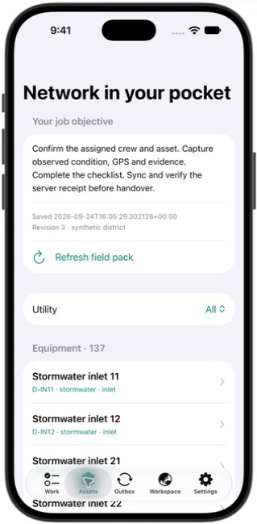
Starting the field practice exercise
01
Choose the utility and locate the exercise equipment.
02
Confirm its ID before opening the inspection or measurement form.
03
Continue through the exercise and verify the resulting receipt in Outbox.
iOS native app · release 0.5 · synthetic training data
Mappls Utility / Mobile manual / 0.5
50
Notes:
Actual local application capture on 24 September 2026. iOS UI illustrates shared native workflows; Android uses platform-specific styling. This screenshot follows the matching procedure. Choose the utility and locate the exercise equipment. Confirm its ID before opening the inspection or measurement form. Continue through the exercise and verify the resulting receipt in Outbox.
1. Choose the utility and locate the exercise equipment.
2. Confirm its ID before opening the inspection or measurement form.
3. Continue through the exercise and verify the resulting receipt in Outbox.
Source: mobile/README.md; mobile/ios/MapplsUtility/MapplsUtilityApp.swift; mobile/android/app/src/main/java/com/mappls/utility/MainActivity.java; app/static/utility.js; app/static/guidance.js; app/verticals/api.py; app/mobile.py; docs/mobile-validation.md
Companion: Mappls Utility Web User Manual

Slide 51
Practice exercise: offline recovery
Field with a reviewer
01
Prepare online
Refresh the field pack and select a training asset. Record the starting pending count.
02
Capture without network access
Create a TRAINING ONLY inspection. Reopen Outbox and confirm it remains locally available.
03
Reconnect and reconcile
Restore connectivity, sync once and inspect the receipt. Refresh the web history and confirm a single accepted record.
Pass: evidence survives the offline period and appears once after acceptance.
Mappls Utility / Mobile manual / 0.5
51
Notes:
Use a disposable training context. Keep any unrelated unsent evidence intact. A dedicated acceptance test can also change a training asset revision from the web to exercise the explicit conflict workflow, under the test owner’s control.
Source: mobile/README.md; mobile/ios/MapplsUtility/MapplsUtilityApp.swift; mobile/android/app/src/main/java/com/mappls/utility/MainActivity.java; app/static/utility.js; app/static/guidance.js; app/verticals/api.py; app/mobile.py; docs/mobile-validation.md
Companion: Mappls Utility Web User Manual

Slide 52
Checking the recovery exercise
01
A queued record is visible under Pending before sync.
02
Reconnect, select Sync queued work and verify the record moves to Server receipts.
03
This screenshot documents the pending stage. The accepted example appears in the Outbox procedure.
iOS native app · release 0.5 · synthetic training data
Mappls Utility / Mobile manual / 0.5
52
Notes:
Actual local application capture on 24 September 2026. iOS UI illustrates shared native workflows; Android uses platform-specific styling. This screenshot follows the matching procedure. A queued record is visible under Pending before sync. Reconnect, select Sync queued work and verify the record moves to Server receipts. This screenshot documents the pending stage. The accepted example appears in the Outbox procedure.
1. A queued record is visible under Pending before sync.
2. Reconnect, select Sync queued work and verify the record moves to Server receipts.
3. This screenshot documents the pending stage. The accepted example appears in the Outbox procedure.
Source: mobile/README.md; mobile/ios/MapplsUtility/MapplsUtilityApp.swift; mobile/android/app/src/main/java/com/mappls/utility/MainActivity.java; app/static/utility.js; app/static/guidance.js; app/verticals/api.py; app/mobile.py; docs/mobile-validation.md
Companion: Mappls Utility Web User Manual

Slide 53
Shift handover checklist
Field and work owner
01
Evidence complete
Review work ID, asset ID, completed checks, observed findings, reading units and relevant attachments.
02
Server state confirmed
Confirm accepted receipts and authoritative work status. Record any unresolved queue item and its owner.
03
Next action assigned
Agree the follow-up, reviewer and due date. Preserve unsent evidence until reconciliation is complete.
Handover record: who reviewed what, when, against which asset and work revision.
Mappls Utility / Mobile manual / 0.5
53
Notes:
For product instructions use /guide and /mobile. For operational authorization use the organization’s approved SOP. Report software issues with role, device, release, module, record ID, time and error, without sharing passwords.
Source: mobile/README.md; mobile/ios/MapplsUtility/MapplsUtilityApp.swift; mobile/android/app/src/main/java/com/mappls/utility/MainActivity.java; app/static/utility.js; app/static/guidance.js; app/verticals/api.py; app/mobile.py; docs/mobile-validation.md
Companion: Mappls Utility Web User Manual

Slide 54
The final handover check
01
Confirm Pending is 0 for all accepted work.
02
Match the receipt IDs to the jobs and evidence handed over.
03
Raise any unresolved records with the responsible engineer before clearing the device.
iOS native app · release 0.5 · synthetic training data
Mappls Utility / Mobile manual / 0.5
54
Notes:
Actual local application capture on 24 September 2026. iOS UI illustrates shared native workflows; Android uses platform-specific styling. This screenshot follows the matching procedure. Confirm Pending is 0 for all accepted work. Match the receipt IDs to the jobs and evidence handed over. Raise any unresolved records with the responsible engineer before clearing the device.
1. Confirm Pending is 0 for all accepted work.
2. Match the receipt IDs to the jobs and evidence handed over.
3. Raise any unresolved records with the responsible engineer before clearing the device.
Source: mobile/README.md; mobile/ios/MapplsUtility/MapplsUtilityApp.swift; mobile/android/app/src/main/java/com/mappls/utility/MainActivity.java; app/static/utility.js; app/static/guidance.js; app/verticals/api.py; app/mobile.py; docs/mobile-validation.md
Companion: Mappls Utility Web User Manual

