Slide 1
mappls
by MapmyIndia
Utility Platform
Seven utility networks across office and field
Web, Android and iOS field workflows
24 September 2026
Mappls Utility Platform / Product overview / Release 0.5
01
Notes:
MapmyIndia implementation based on the supplied PFC presentation and product datasheet, extended to seven utilities. Synthetic demonstration data. This is an engineering evaluation, not a certified operational control system.

Slide 2
Connect utility decisions to the network
One working environment for infrastructure owners, engineers and field teams.
Know what is connected
Understand service impact
Bring assets, service links and required dependencies into a shared geographic record.
Explore failures and alternate paths before handing a documented assessment to the reviewer.
Carry work through to evidence
Help each role do its job
Connect design, field checklists, observations and revision-aware acceptance.
Show the objective, procedure, expected output and next handover within every module.
Mappls Utility Platform / Product overview / Release 0.5
02
Notes:
Benefits describe supported workflows, not measured productivity or outage-reduction claims.

Slide 3
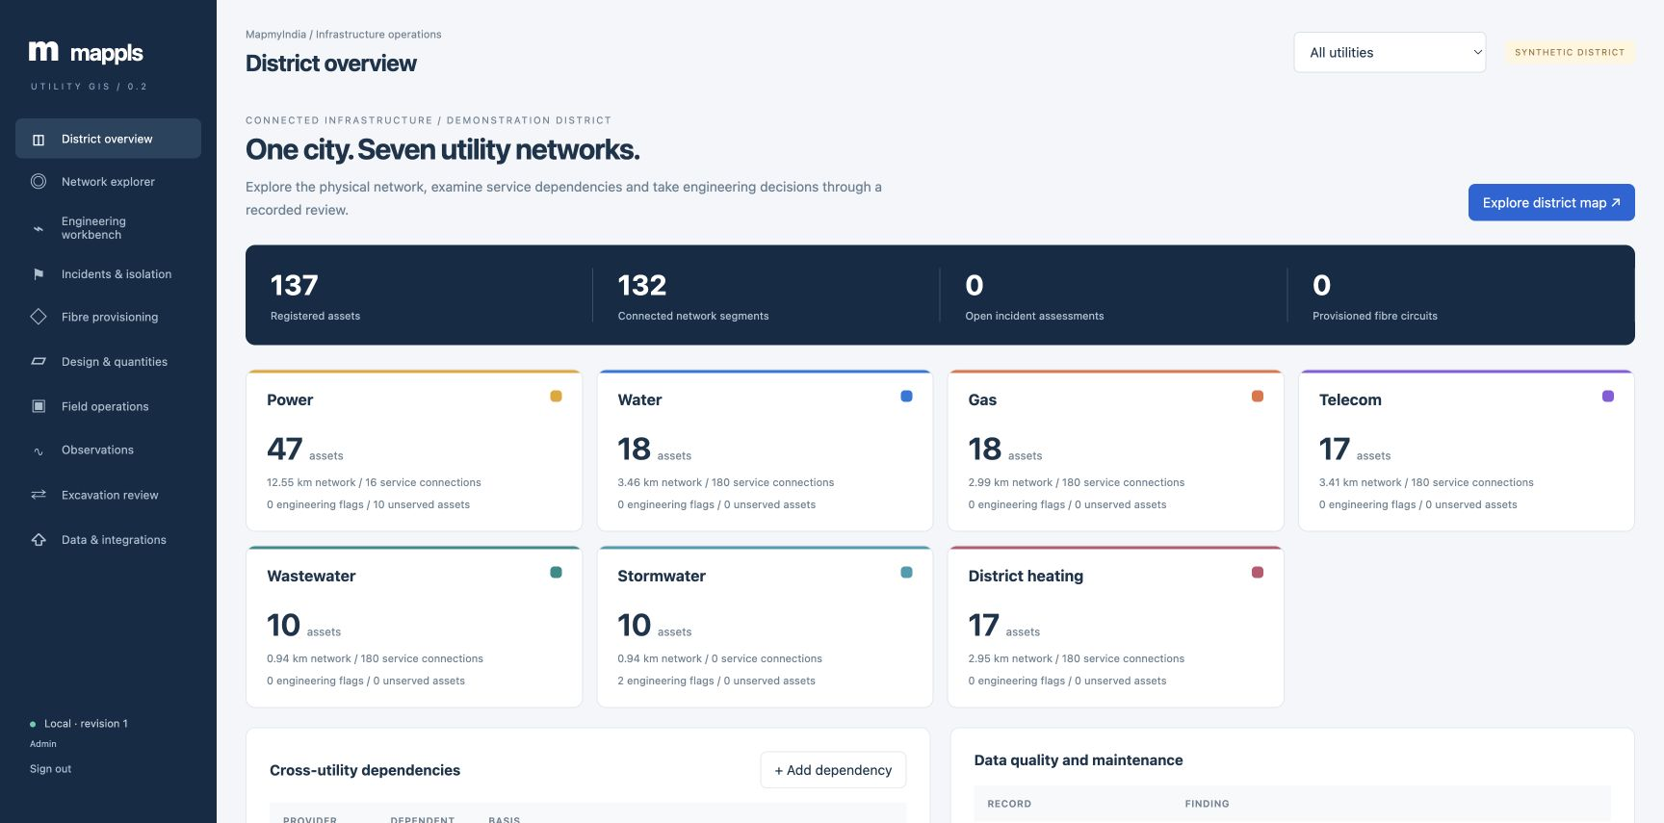
A district across seven utilities
Power, water, gas, telecom, wastewater, stormwater and district heating.
137 synthetic assets and 132 network segments, with recorded service dependencies.
Mappls Utility Platform / Product overview / Release 0.5
03
Notes:
Screenshot of the running Mappls Utility Platform local Docker evaluation, captured 24 September 2026. Utility records are synthetic. Basemap attribution remains visible. 137 synthetic assets and 132 network segments, with recorded service dependencies.

Slide 4
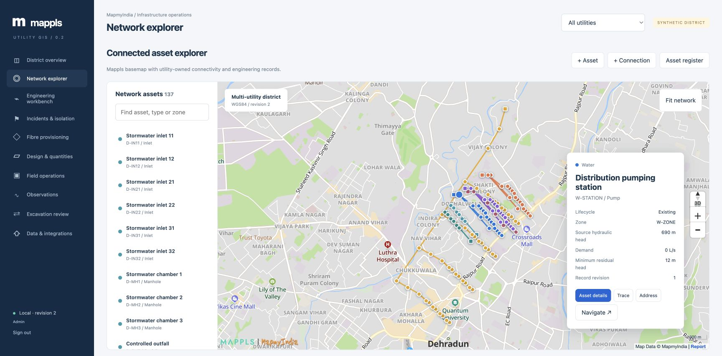
Mappls network explorer
Select a utility, inspect equipment and follow its physical connections.
Mappls vector basemap, utility overlays, address lookup and navigation links.
Mappls Utility Platform / Product overview / Release 0.5
04
Notes:
Screenshot of the running Mappls Utility Platform local Docker evaluation, captured 24 September 2026. Utility records are synthetic. Basemap attribution remains visible. Mappls vector basemap, utility overlays, address lookup and navigation links.

Slide 5
Mappls service foundation
Location services use Mappls; utility topology and engineering run in the application.
Service | Implementation | Status
Vector maps | Mappls Web JS SDK v3 | Connected
Address context | Mappls reverse geocoding | Connected
Navigation | Mappls asset directions link | Available
mGIS spatial services | Tenant layers and analytics | Access not configured
InTouch / Workmate | Telemetry and workforce APIs | Tenant integration required
Local spatial engine | PostGIS registry and proximity | Implemented
Mappls Utility Platform / Product overview / Release 0.5
05
Notes:
Mappls official mGIS SDK methods: https://developer.mappls.com/documentation/sdk/Web/Web%20JS/docs/V3.0/mGIS_Methods/ . Product: https://about.mappls.com/api/mgis-api/ . No verified mGIS tenant token is available in this deployment. No alternate basemap is used.

Slide 6
Power distribution
Electrical asset semantics from source equipment through customer connections.
Typed electrical topology
Supply and outage analysis
Substations, transformers, controls, conductors and consumers; voltage and phase validation.
Open switches stop traversal. Trace sources or downstream services and apply failure scenarios.
Engineering screening
Controlled changes
Transformer nameplate loading and line current estimates with explicit power-factor assumptions.
Revision checks, lifecycle transitions and administrator approval before commissioning.
Full load flow, protection coordination and physical switching remain outside this release.
Mappls Utility Platform / Product overview / Release 0.5
06
Notes:
Implementation: app/verticals/catalog.py, engineering.py and api.py. The original power evaluation remains at /power-v1 with its original eight trace modes.

Slide 7
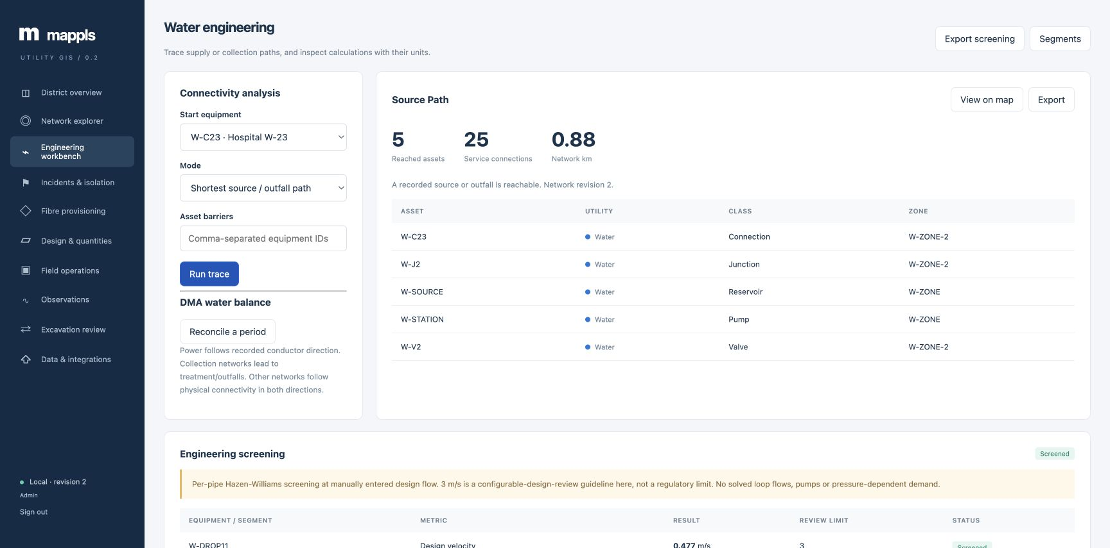
Water distribution engineering
Connected DMA assets with valve boundaries and alternate ring supply.
Pipe velocity, Hazen–Williams head loss and a water-balance calculator use explicit units.
Mappls Utility Platform / Product overview / Release 0.5
07
Notes:
Screenshot of the running Mappls Utility Platform local Docker evaluation, captured 24 September 2026. Utility records are synthetic. Basemap attribution remains visible. Pipe velocity, Hazen–Williams head loss and a water-balance calculator use explicit units.

Slide 8
Gas distribution
A gas-specific register with pressure, integrity and service-impact workflows.
Asset and pressure records
Isolation assessment
City gates, regulators, valves, meters and CP test posts; pressure and MAOP in bar(g).
Find bounding controls and test connectivity after proposed closures, including affected services.
Inspection measurements
Review triggers
Record pressure, leak concentration and CP potential with timestamps and field evidence.
Observed gas concentration and pressure above recorded MAOP generate review flags.
No gas-flow simulation, CP compliance certification or operational isolation clearance.
Mappls Utility Platform / Product overview / Release 0.5
08
Notes:
Implementation: gas catalog, engineering screening, metrics and isolation endpoints. Closed fluid valves stop traversal; electrical open-switch semantics are not reused for gas.

Slide 9
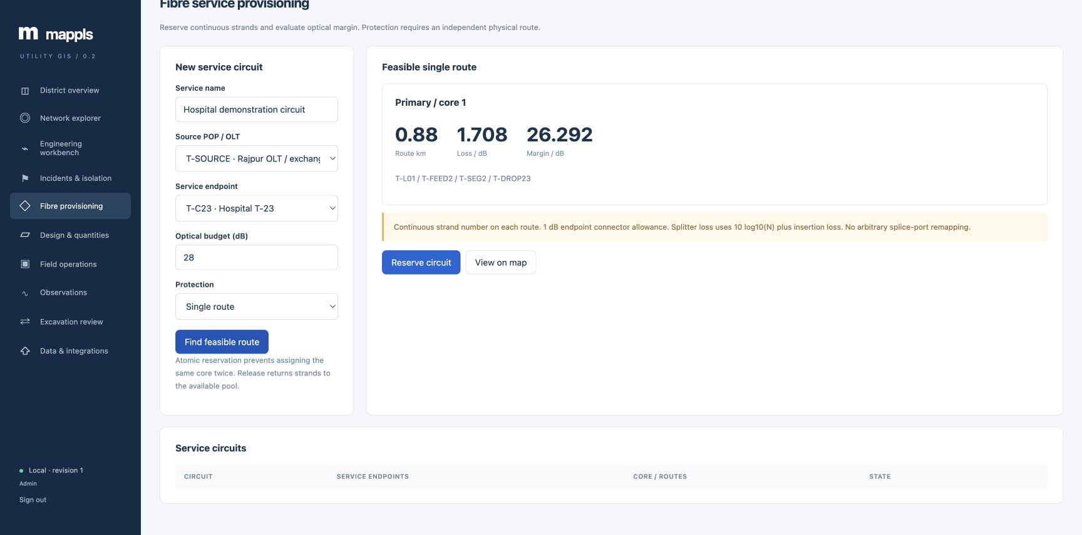
Telecom fibre provisioning
Reserve a continuous available strand along a feasible optical route.
The hospital scenario: 0.88 km, 1.708 dB modelled loss and 26.292 dB margin.
Mappls Utility Platform / Product overview / Release 0.5
09
Notes:
Screenshot of the running Mappls Utility Platform local Docker evaluation, captured 24 September 2026. Utility records are synthetic. Basemap attribution remains visible. The hospital scenario: 0.88 km, 1.708 dB modelled loss and 26.292 dB margin.

Slide 10
Wastewater and stormwater
Collection networks preserve flow direction toward an outfall or treatment works.
Utility | Engineering model | Review output
Wastewater | Invert-based slope and Manning capacity | Non-falling pipe or capacity exceedance
Stormwater | Rational runoff and accumulated catchments | Runoff demand versus drain capacity
Both networks | Directed trace to the receiving outfall | Service impact from blocked segments
Field operations | Flow, level and rainfall observations | Timestamped readings and maintenance
Circular full-flow screening; no backwater, surcharge, flood routing or pump-curve solver.
Mappls Utility Platform / Product overview / Release 0.5
10
Notes:
Manning Q=(1/n)AR^(2/3)S^(1/2). Rational runoff Q=2.77778 C i A in L/s with i in mm/h and A in hectares. Implemented assumptions are disclosed in docs/engineering-models.md.

Slide 11
District heating
Thermal network records connect demand, circulation and recorded pipe losses.
Engineering input | Screening output
Thermal demand / kW | Required mass flow at entered temperature difference
Supply and return / °C | Temperature difference review
Pipe loss / W per metre | Segment heat-loss estimate
Valves and required dependencies | Connectivity-based service disruption
Temperature and energy observations | Timestamped operating record
Steady water-based screening; coupled hydraulic and thermal simulation remains future work.
Mappls Utility Platform / Product overview / Release 0.5
11
Notes:
Mass flow = demand_kW/(4.186 × deltaT_K), kg/s. Pipe heat loss = length_m × loss_W_m. No transient thermal model or operational dispatch.

Slide 12
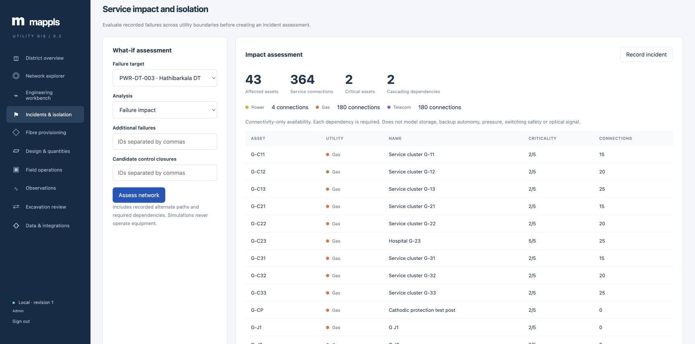
Cross-utility service impact
A transformer failure can interrupt the dependent telecom and gas networks.
The scenario follows explicitly recorded required dependencies; backup runtime is not assumed.
Mappls Utility Platform / Product overview / Release 0.5
12
Notes:
Screenshot of the running Mappls Utility Platform local Docker evaluation, captured 24 September 2026. Utility records are synthetic. Basemap attribution remains visible. The scenario follows explicitly recorded required dependencies; backup runtime is not assumed.

Slide 13
Recorded incident and review workflows
Assess a scenario against a known network revision and retain its decision history.
Reported → Assessed → Approved → Resolved → Closed
Revision-aware approval
Advisory isolation
Changes to the network invalidate approval until the incident is reassessed.
Candidate controls are checked for connectivity isolation and downstream impact.
Documented resolution
Explicit model limits
Resolution notes and administrator closure preserve the review history.
No equipment actuation, switching order, purge procedure or physical clearance.
Mappls Utility Platform / Product overview / Release 0.5
13
Notes:
Implemented incident state machine and isolation algorithm. The candidate control set is not claimed to be a minimum cut.

Slide 14
Multi-utility design and quantities
Plan connected equipment and segments using the same typed utility model.
Stage | Implemented behavior
Draft / revise | Validate endpoints, attributes and permitted utility connections
Quantities | Count assets and measure segments; apply entered INR unit rates
Submit / approve | Record role, version and network revision
Commission | Atomically create the reviewed assets and connections
Later edits | Reject stale versions and incompatible lifecycle changes
Quantity estimates exclude route survey, fittings, wastage, labour and statutory approvals.
Mappls Utility Platform / Product overview / Release 0.5
14
Notes:
API /api/v2/plans supports revisions, BOM and controlled commissioning. Segment lengths derive from WGS84 endpoints, not surveyed route chains.

Slide 15
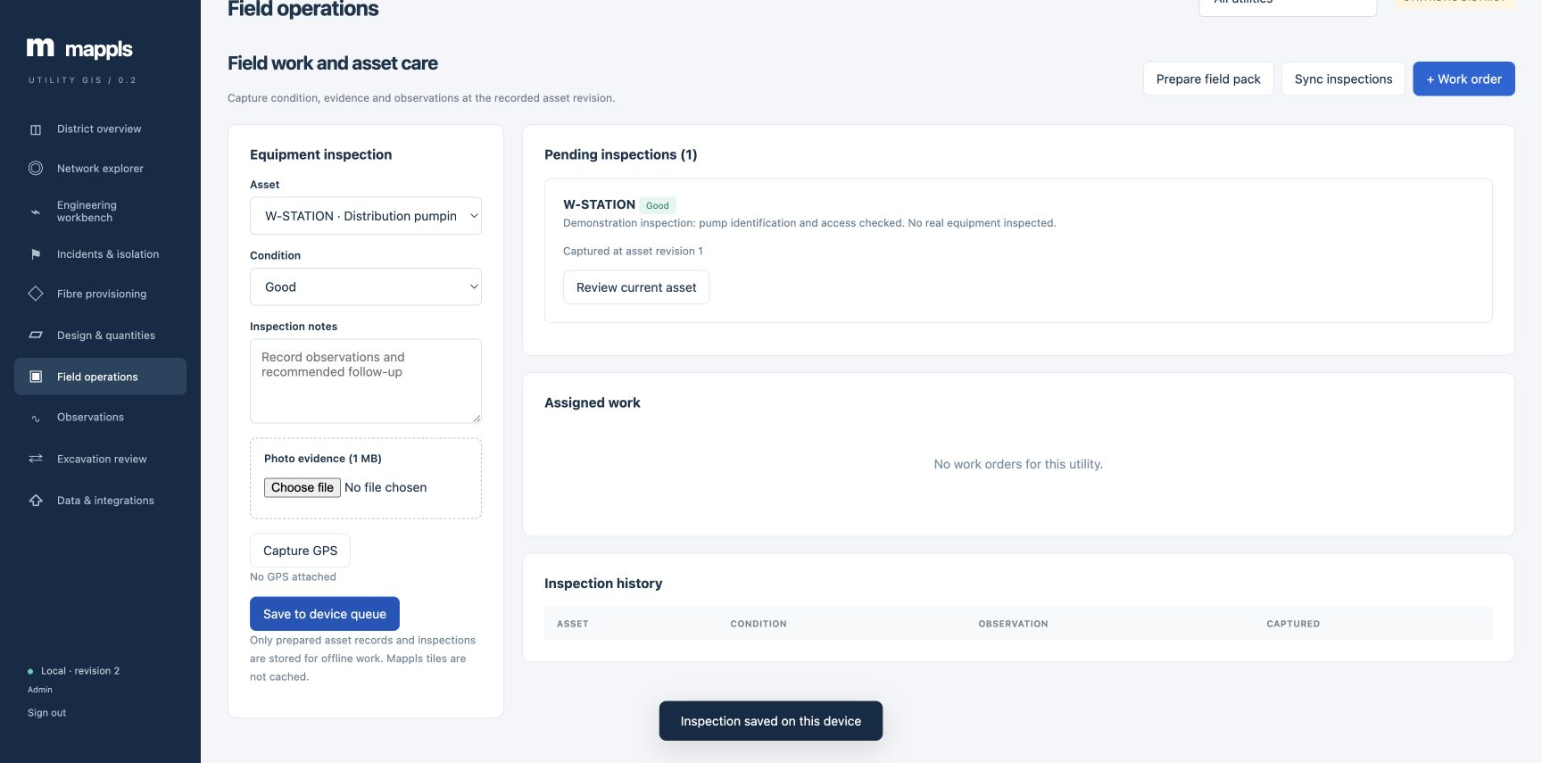
Field operations across utilities
Utility-specific maintenance checklists, inspections and timestamped measurements.
Web field workspace shown. Native Android and iOS apps add encrypted field evidence queues.
Mappls Utility Platform / Product overview / Release 0.5
15
Notes:
Screenshot of the running Mappls Utility Platform local Docker evaluation, captured 24 September 2026. Utility records are synthetic. Basemap attribution remains visible. Offline asset packs and an inspection outbox support capture and explicit conflict review.

Slide 16

Native mobile field apps
Android and iOS put downloaded equipment and work records in the crew’s hands.
Work and asset context
Find a job, confirm its equipment and review the checklist before field work.
Evidence at the equipment
Record condition, GPS/photo inspections and measurements in the stated unit.
Continuity with the office
Encrypted queues retain evidence until sync. Receipts confirm server acceptance.
Complete online workspace
All ten modules remain accessible inside the app, with the same role permissions.
Mappls Utility Platform / Product overview / Release 0.5
16
Notes:
Implemented native field pilot, release 0.5. Source: mobile/README.md and docs/mobile-validation.md in https://gitlab.mapmyindia.com/rohan/mappls-utility-gis . Field screens are native; ten wider modules use the online embedded web workspace. Company signing and physical-device acceptance remain rollout gates.

Slide 17
Offline work and synchronization
A local save becomes a shared record after the server accepts it.
Stage | Native field workflow
Prepare online | Sign in, refresh the field pack and check the saved revision.
Capture in the field | Queue inspections, measurements and checklist transitions.
Synchronize | Reconnect, renew sign-in if needed and inspect each receipt.
Resolve conflicts | Compare the changed record before explicitly retrying or reconciling.
Complete the handover | Confirm the work state and resolve unsent evidence before sign-out.
Mappls maps and engineering need connectivity. Sync is foreground and user-triggered.
Mappls Utility Platform / Product overview / Release 0.5
17
Notes:
Implemented native field pilot, release 0.5. Source: mobile/README.md and docs/mobile-validation.md in https://gitlab.mapmyindia.com/rohan/mappls-utility-gis . Field screens are native; ten wider modules use the online embedded web workspace. Company signing and physical-device acceptance remain rollout gates.

Slide 18
Every role across devices
Native field tasks and the online workspace support the same operating responsibilities.
Role | Native field use | Online Workspace use
Field engineer | Jobs, checks, inspection evidence and readings | Work history and network context
Network engineer | Verify assets and collect observations | Engineering, incidents and reviewed designs
Administrator | Review field context and work progress | Approvals, data quality and administration
Viewer | Read downloaded equipment and work | Review records and progress, without editing
Shared roles define access in this pilot. Crew search does not enforce crew-level authorization.
Mappls Utility Platform / Product overview / Release 0.5
18
Notes:
Implemented native field pilot, release 0.5. Source: mobile/README.md and docs/mobile-validation.md in https://gitlab.mapmyindia.com/rohan/mappls-utility-gis . Field screens are native; ten wider modules use the online embedded web workspace. Company signing and physical-device acceptance remain rollout gates.

Slide 19
Mobile pilot availability
A defined device acceptance process precedes customer distribution.
Available for evaluation
Required before rollout
Android development APK for Android 8+. iOS simulator and Xcode source for iOS 17+.
Company signing, a verified HTTPS service, device GPS/camera and offline-shift acceptance.
Local evidence protection
Planned mobile depth
Authenticated encryption protects native packs and queues. Browser queues remain separate.
Named identity and crew scopes, licensed offline maps, delta sync and managed dispatch.
No public App Store or Google Play release is claimed. Live cloud/domain verification is pending.
Mappls Utility Platform / Product overview / Release 0.5
19
Notes:
Implemented native field pilot, release 0.5. Source: mobile/README.md and docs/mobile-validation.md in https://gitlab.mapmyindia.com/rohan/mappls-utility-gis . Field screens are native; ten wider modules use the online embedded web workspace. Company signing and physical-device acceptance remain rollout gates.

Slide 20
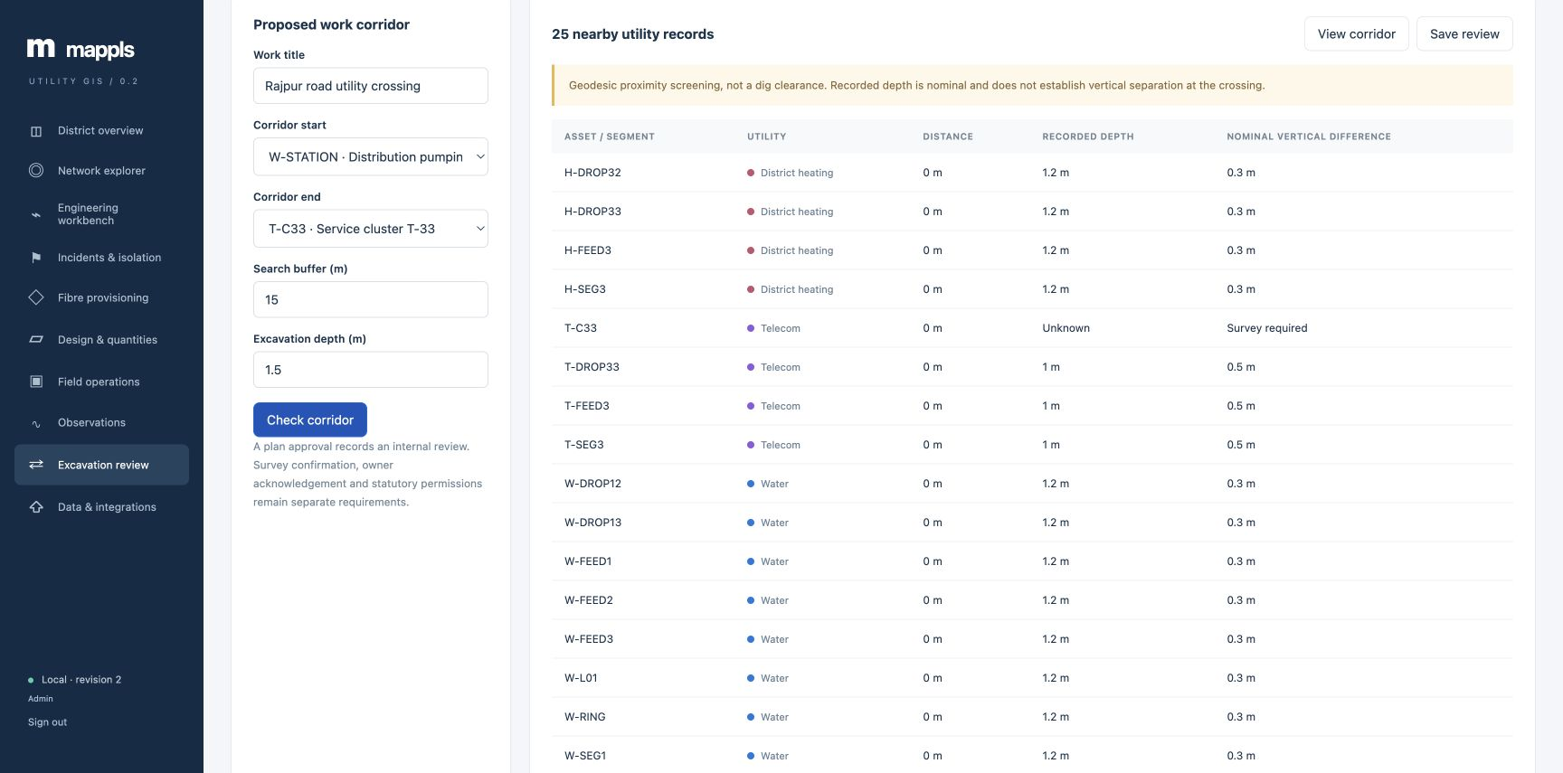
Excavation corridor review
Check a proposed alignment against every utility using geodesic proximity.
Nearby assets, segment distances and nominal depth differences support an internal review.
Mappls Utility Platform / Product overview / Release 0.5
20
Notes:
Screenshot of the running Mappls Utility Platform local Docker evaluation, captured 24 September 2026. Utility records are synthetic. Basemap attribution remains visible. Nearby assets, segment distances and nominal depth differences support an internal review.

Slide 21
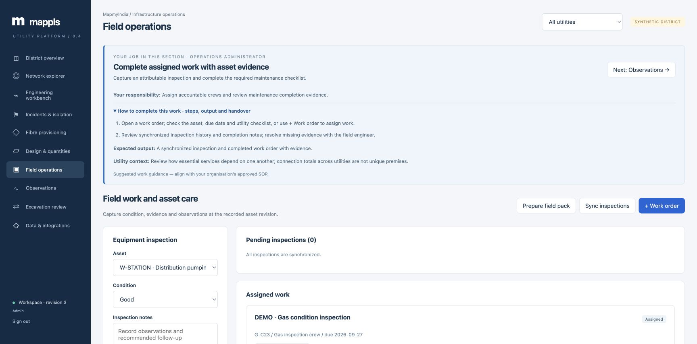
Guidance in the flow of work
Four role paths across ten modules explain objectives, actions and handovers.
Administrator • Engineer • Field • Viewer — linked to the detailed user guide.
Mappls Utility Platform / Product overview / Release 0.5
21
Notes:
Screenshot of the running Mappls Utility Platform local Docker evaluation, captured 24 September 2026. Utility records are synthetic. Basemap attribution remains visible. Administrator • Engineer • Field • Viewer — linked to the detailed user guide.

Slide 22
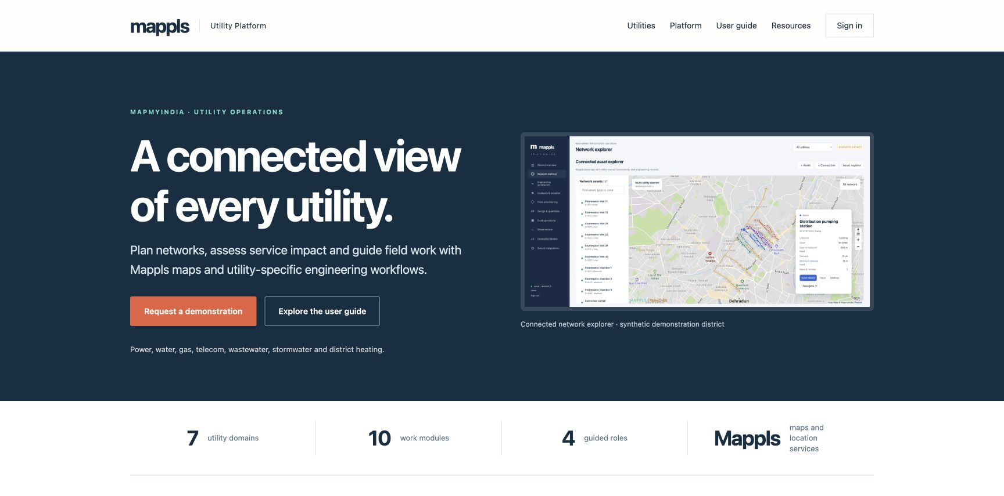
A product website that starts the conversation
Public features, utility coverage, benefits, resources and an enquiry form.
Enquiries receive a reference and enter a private administrator inbox with follow-up history.
Mappls Utility Platform / Product overview / Release 0.5
22
Notes:
Screenshot of the running Mappls Utility Platform local Docker evaluation, captured 24 September 2026. Utility records are synthetic. Basemap attribution remains visible. Enquiries receive a reference and enter a private administrator inbox with follow-up history.

Slide 23
Migration and integration boundaries
Import connected utility records and retain an auditable source of change.
Atomic GeoJSON import
Export and review
Typed points and two-endpoint lines; dry-run checks, duplicates and endpoint geometry validation.
Network GeoJSON, inventory CSV, engineering results and priced quantities.
Operational integrity
Enterprise adapters
Idempotent field uploads, transaction locks for fibre allocation and a verifiable audit chain.
mGIS, telemetry, ERP, billing and OMS need tenant access and agreed data contracts.
Mappls Utility Platform / Product overview / Release 0.5
23
Notes:
V2 GeoJSON handles points and two-vertex lines. Legacy power module retains CSV point import and a labelled CIM equipment subset. No certified CIM profile, live telemetry adapter or enterprise SSO is represented as implemented.

Slide 24
A deployable product foundation
Public product information and a protected utility workspace.
Layer | Delivery
User experience | Web platform and native Android / iOS field apps
Location services | Mappls vector SDK, Search API and navigation link
Engineering application | FastAPI with seven typed utility domains
Spatial database | PostgreSQL 16 / PostGIS and geographic indexes
Delivery | Docker locally; mobile pilot; cloud verification pending
Source and materials | Private GitLab project: rohan/mappls-utility-gis
Mappls Utility Platform / Product overview / Release 0.5
24
Notes:
Compose binds application to 127.0.0.1 only. Non-root application, read-only filesystem, no published database port. Credentials are excluded from Git. https://gitlab.mapmyindia.com/rohan/mappls-utility-gis

Slide 25
Pilot acceptance
Start with a defined service area, accountable owners and measurable acceptance.
01
Reconcile surveyed networks
Validate identifiers, connectivity, control states and cross-utility dependencies.
02
Calibrate domain models
Agree engineering thresholds and integrate specialised solvers where required.
03
Connect licensed enterprise services
Activate mGIS, identity, billing, telemetry and workforce tenant interfaces.
04
Prove operational readiness
Validate signed devices, offline recovery, security and engineering review.
Mappls Utility Platform / Product overview / Release 0.5
25
Notes:
Demonstration release 0.5 with native Android and iOS field pilots. Company signing and physical-device acceptance precede customer distribution. Enterprise certification, HA, performance SLAs and full hydraulic/electrical simulation are not established.

