Slide 1
mappls
by MapmyIndia
Web app user manual
Release 0.5 / All ten modules / Roles, procedures and worked examples
Operating procedures and step-by-step use
24 September 2026
Notes:
Mappls Utility Platform release 0.5 pilot. This manual covers implemented software behavior and training examples. Organization-approved physical operating procedures remain separate. Credentials are provided privately. Content source: MapmyIndia repository https://gitlab.mapmyindia.com/rohan/mappls-utility-gis .

Slide 2
Manual contents
Section | Topics | Slides
Getting started | Roles, module directory, sign-in and terms | 3–9
Network and engineering | Overview, registry, traces and screening | 10–25
Service and design | Incidents, fibre and reviewed extensions | 26–35
Work and evidence | Assignments, inspections, readings and corridors | 36–46
Data and support | Imports, audit, enquiries, recovery and practice | 47–61
Each illustrated procedure is followed by a matching app screen. Use Slide Sorter or the slide numbers to navigate.
Mappls Utility / Web manual / 0.5
02
Notes:
Each illustrated procedure is followed by a matching app screen. Use Slide Sorter or the slide numbers to navigate.
Source: mobile/README.md; mobile/ios/MapplsUtility/MapplsUtilityApp.swift; mobile/android/app/src/main/java/com/mappls/utility/MainActivity.java; app/static/utility.js; app/static/guidance.js; app/verticals/api.py; app/mobile.py; docs/mobile-validation.md
Companion: Mappls Utility Mobile User Manual

Slide 3
Using the operating workspace
All roles
01
Establish the baseline
Verify equipment, connections, units and revisions before analysis or field assignment.
02
Follow the work cycle
Investigate, prepare a reviewed response or design, assign work and reconcile accepted evidence.
03
Retain accountability
Use inline role guidance, record IDs and review notes to make each handover clear.
Outcome: a traceable record of the utility work and its review.
Mappls Utility / Web manual / 0.5
03
Notes:
This manual describes the implemented pilot. Software guidance is not an organization-approved physical operating procedure. Synthetic demonstration records support practice. Sign-in credentials are supplied separately from this shareable manual.
Source: mobile/README.md; mobile/ios/MapplsUtility/MapplsUtilityApp.swift; mobile/android/app/src/main/java/com/mappls/utility/MainActivity.java; app/static/utility.js; app/static/guidance.js; app/verticals/api.py; app/mobile.py; docs/mobile-validation.md
Companion: Mappls Utility Mobile User Manual

Slide 4
Role permissions
Action | Admin | Engineer | Field | Viewer
Read records / analyze / export | Yes | Yes | Yes | Yes
Edit registry / assign / draft / reserve | Yes | Yes | No | No
Inspect / read meters / complete work | Yes | Yes | Yes | No
Approve / commission / close reviews | Yes | No | No | No
Enquiry inbox / audit verification | Yes | No | No | No
Shared roles are the pilot access model. Individual crew authorization is not implemented.
Mappls Utility / Web manual / 0.5
04
Notes:
Shared roles are the pilot access model. Individual crew authorization is not implemented.
Source: app/verticals/api.py; app/public_site.py; app/main.py
Companion: Mappls Utility Mobile User Manual

Slide 5
Where each job belongs
Objective | Module | Primary owner
Priorities and baseline | District overview / Network explorer | Administrator / Engineer
Service and capacity analysis | Engineering / Incidents / Fibre | Engineer, with admin review
Change and delivery | Design & quantities / Field operations | Engineer / Field / Administrator
Evidence and shared corridors | Observations / Excavation review | Field / Engineer / Administrator
Data and governance | Data & integrations | Engineer / Administrator
Each module includes a role objective, procedure, expected output and suggested next module.
Mappls Utility / Web manual / 0.5
05
Notes:
Each module includes a role objective, procedure, expected output and suggested next module.
Source: mobile/README.md; mobile/ios/MapplsUtility/MapplsUtilityApp.swift; mobile/android/app/src/main/java/com/mappls/utility/MainActivity.java; app/static/utility.js; app/static/guidance.js; app/verticals/api.py; app/mobile.py; docs/mobile-validation.md
Companion: Mappls Utility Mobile User Manual

Slide 6
Sign-in and the first session
All roles
01
Open the workspace
Use http://localhost:8190 for the local Docker evaluation. Select the requested role and enter its password.
02
Select the utility
Use Utility sector at the top right. All utilities gives district context across seven networks.
03
Read your guidance
Review the inline job objective and role steps before changing records or running an assessment.
Check: the sidebar role and selected utility match the task.
Mappls Utility / Web manual / 0.5
06
Notes:
No username is required beyond the role selector in this pilot. The web and native apps use the same role credentials. A web session lasts eight hours. Keep passwords out of shared manuals and screenshots.
Source: mobile/README.md; mobile/ios/MapplsUtility/MapplsUtilityApp.swift; mobile/android/app/src/main/java/com/mappls/utility/MainActivity.java; app/static/utility.js; app/static/guidance.js; app/verticals/api.py; app/mobile.py; docs/mobile-validation.md
Companion: Mappls Utility Mobile User Manual

Slide 7
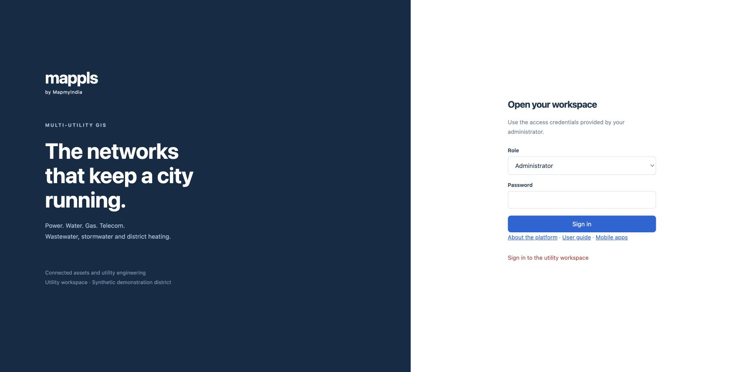
Web sign-in
Select Role, enter the separately supplied password, then Sign in.
Mappls Utility / Web manual / 0.5
07
Notes:
Actual local application capture on 24 September 2026. This screenshot follows the matching procedure. Select Role, enter the separately supplied password, then Sign in.
1. Select Role, enter the separately supplied password, then Sign in.
Source: mobile/README.md; mobile/ios/MapplsUtility/MapplsUtilityApp.swift; mobile/android/app/src/main/java/com/mappls/utility/MainActivity.java; app/static/utility.js; app/static/guidance.js; app/verticals/api.py; app/mobile.py; docs/mobile-validation.md
Companion: Mappls Utility Mobile User Manual

Slide 8
Terms and record versions
All roles
01
Asset and segment
An asset identifies equipment. A segment connects source and target equipment within one utility.
02
Record and network revision
Record versions protect concurrent edits. Network revision identifies the topology used for an assessment.
03
Preview and recorded action
Viewing or calculating a preview does not reserve a circuit, approve a design or record a new incident.
Check: retain IDs and revision context with every exported or reviewed result.
Mappls Utility / Web manual / 0.5
08
Notes:
A service-connection count is not a unique-premises count across utilities. Source/outfall connectivity is a graph result. Engineering screening reports simplified calculations with stated assumptions.
Source: mobile/README.md; mobile/ios/MapplsUtility/MapplsUtilityApp.swift; mobile/android/app/src/main/java/com/mappls/utility/MainActivity.java; app/static/utility.js; app/static/guidance.js; app/verticals/api.py; app/mobile.py; docs/mobile-validation.md
Companion: Mappls Utility Mobile User Manual

Slide 9
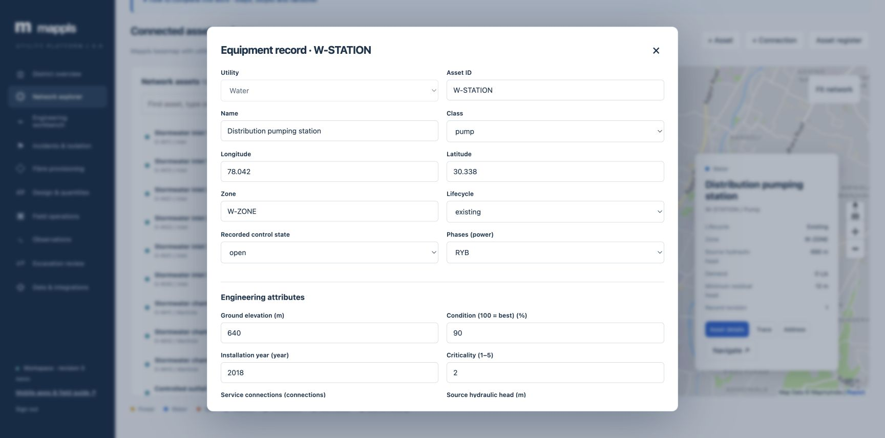
Record identity and engineering attributes
Asset ID identifies the equipment. Lifecycle and Recorded control state describe different aspects of the model.
Mappls Utility / Web manual / 0.5
09
Notes:
Actual local application capture on 24 September 2026. This screenshot follows the matching procedure. Asset ID identifies the equipment. Lifecycle and Recorded control state describe different aspects of the model.
1. Asset ID identifies the equipment. Lifecycle and Recorded control state describe different aspects of the model.
Source: mobile/README.md; mobile/ios/MapplsUtility/MapplsUtilityApp.swift; mobile/android/app/src/main/java/com/mappls/utility/MainActivity.java; app/static/utility.js; app/static/guidance.js; app/verticals/api.py; app/mobile.py; docs/mobile-validation.md
Companion: Mappls Utility Mobile User Manual

Slide 10
District review and prioritization
Administrator / Engineer
01
Review the district
Open District overview and select All utilities or the utility of interest.
02
Investigate exceptions
Compare assets, connections, unserved equipment, engineering flags and recorded dependencies.
03
Assign the next step
Open Network explorer or Incidents & isolation with a clear asset ID, issue and responsible owner.
Outcome: a prioritized investigation or work handover.
Mappls Utility / Web manual / 0.5
10
Notes:
Viewer reviews the same indicators and passes discrepancies to the owner. Field users use the overview for context before opening their work assignment. Demonstration values are not live operational telemetry.
Source: mobile/README.md; mobile/ios/MapplsUtility/MapplsUtilityApp.swift; mobile/android/app/src/main/java/com/mappls/utility/MainActivity.java; app/static/utility.js; app/static/guidance.js; app/verticals/api.py; app/mobile.py; docs/mobile-validation.md
Companion: Mappls Utility Mobile User Manual

Slide 11
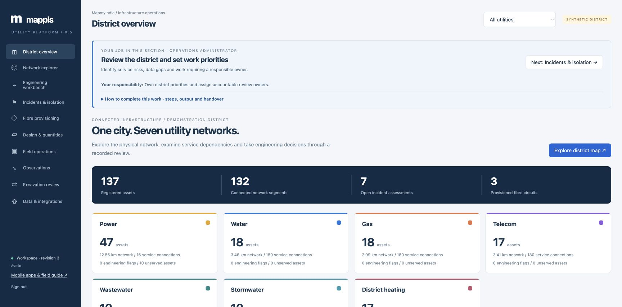
District review on screen
Read the district totals, open a utility card and assign investigation of the findings.
Mappls Utility / Web manual / 0.5
11
Notes:
Actual local application capture on 24 September 2026. This screenshot follows the matching procedure. Read the district totals, open a utility card and assign investigation of the findings.
1. Read the district totals, open a utility card and assign investigation of the findings.
Source: mobile/README.md; mobile/ios/MapplsUtility/MapplsUtilityApp.swift; mobile/android/app/src/main/java/com/mappls/utility/MainActivity.java; app/static/utility.js; app/static/guidance.js; app/verticals/api.py; app/mobile.py; docs/mobile-validation.md
Companion: Mappls Utility Mobile User Manual

Slide 12
Finding and verifying an asset
All roles
01
Search and select
Choose the utility in Network explorer. Search the equipment list and select the matching record.
02
Inspect the asset
Open Asset details or Asset register. Check class, zone, lifecycle, coordinates and engineering attributes.
03
Check context
Use Trace for connectivity, Address for reverse geocoding or Navigate for a directions link.
Outcome: the correct asset and revision for analysis or field capture.
Mappls Utility / Web manual / 0.5
12
Notes:
Fit network adjusts the extent. Internet access and the licensed Mappls service are needed for the basemap. Search results and tabular equipment data can still establish that records exist when map loading fails.
Source: mobile/README.md; mobile/ios/MapplsUtility/MapplsUtilityApp.swift; mobile/android/app/src/main/java/com/mappls/utility/MainActivity.java; app/static/utility.js; app/static/guidance.js; app/verticals/api.py; app/mobile.py; docs/mobile-validation.md
Companion: Mappls Utility Mobile User Manual

Slide 13
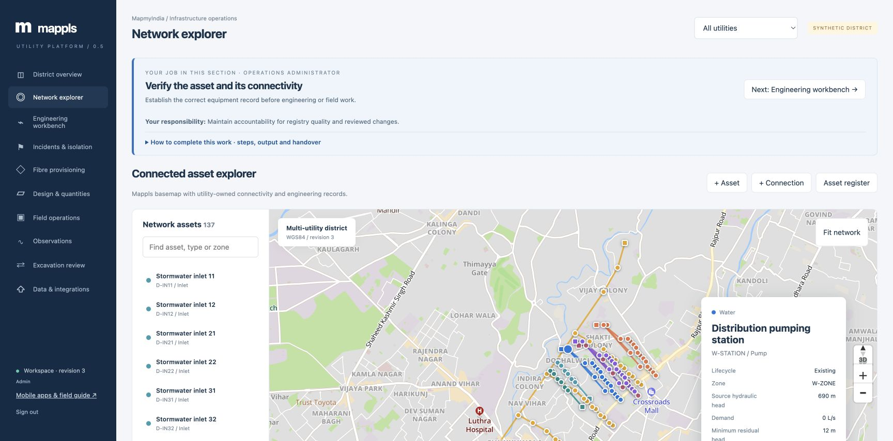
Asset selection on the Mappls map
Filter the list, select equipment and inspect its card. Scroll down to the details and trace actions.
Mappls Utility / Web manual / 0.5
13
Notes:
Actual local application capture on 24 September 2026. This screenshot follows the matching procedure. Filter the list, select equipment and inspect its card. Scroll down to the details and trace actions.
1. Filter the list, select equipment and inspect its card. Scroll down to the details and trace actions.
Source: mobile/README.md; mobile/ios/MapplsUtility/MapplsUtilityApp.swift; mobile/android/app/src/main/java/com/mappls/utility/MainActivity.java; app/static/utility.js; app/static/guidance.js; app/verticals/api.py; app/mobile.py; docs/mobile-validation.md
Companion: Mappls Utility Mobile User Manual

Slide 14
Asset and connection maintenance
Engineer / Administrator
01
Use verified source evidence
Confirm the equipment ID, utility type, coordinates, lifecycle and required typed attributes.
02
Create or revise
Use + Asset or Asset details. Use + Connection to identify source/target equipment and segment attributes.
03
Reconcile the result
Refresh the register, inspect the connection on the map and rerun the relevant trace.
Check: source and target belong to the same utility and the intended route.
Mappls Utility / Web manual / 0.5
14
Notes:
Maintain asset identity and engineering units. Imported line geometry uses two endpoints in this implementation. Treat endpoint length as an approximation where the surveyed route differs. Revised records can invalidate stale analyses and field evidence.
Source: mobile/README.md; mobile/ios/MapplsUtility/MapplsUtilityApp.swift; mobile/android/app/src/main/java/com/mappls/utility/MainActivity.java; app/static/utility.js; app/static/guidance.js; app/verticals/api.py; app/mobile.py; docs/mobile-validation.md
Companion: Mappls Utility Mobile User Manual

Slide 15
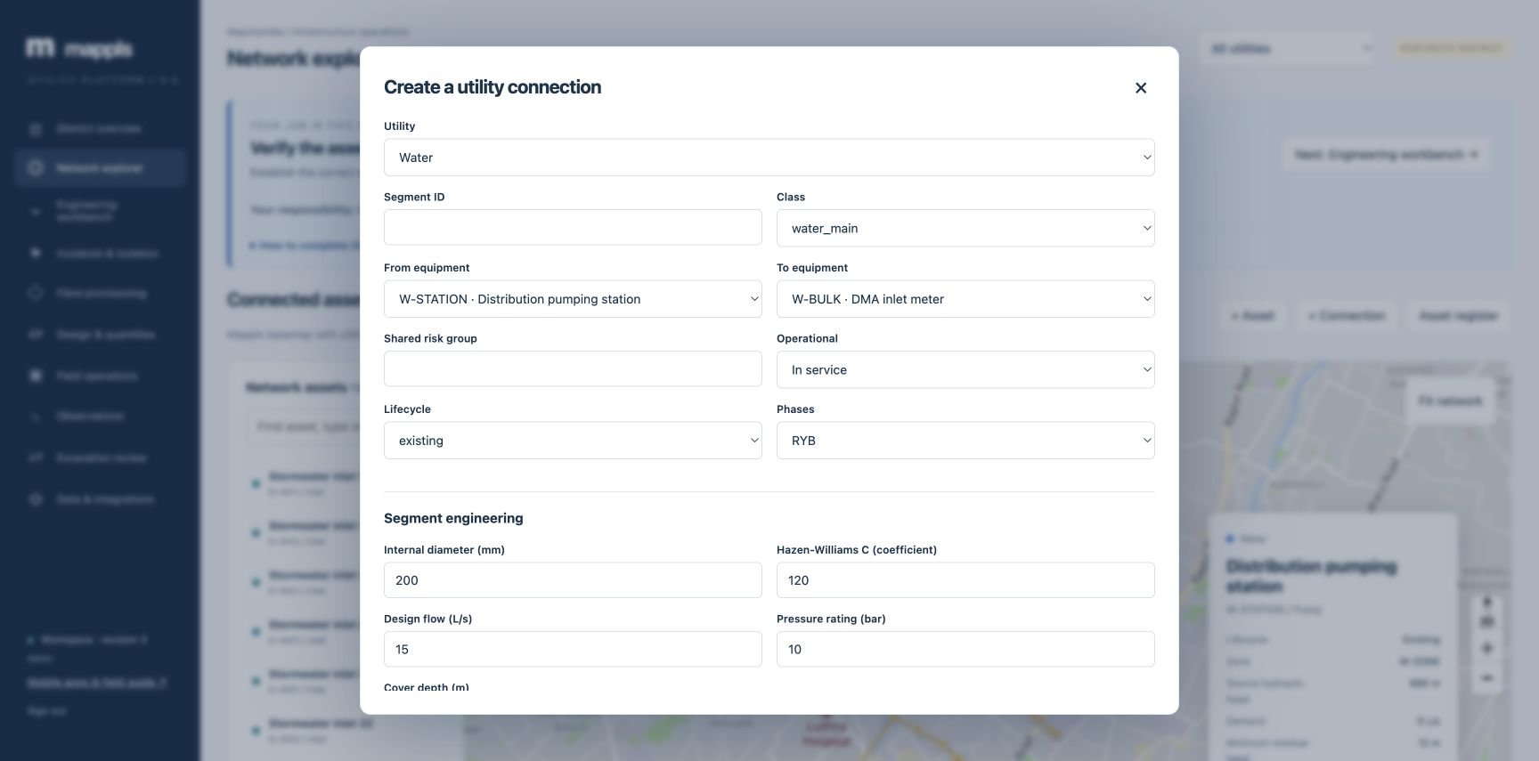
Connection editing on screen
Enter the endpoints and segment attributes, then review the units before Save connection.
Mappls Utility / Web manual / 0.5
15
Notes:
Actual local application capture on 24 September 2026. This screenshot follows the matching procedure. Enter the endpoints and segment attributes, then review the units before Save connection.
1. Enter the endpoints and segment attributes, then review the units before Save connection.
Source: mobile/README.md; mobile/ios/MapplsUtility/MapplsUtilityApp.swift; mobile/android/app/src/main/java/com/mappls/utility/MainActivity.java; app/static/utility.js; app/static/guidance.js; app/verticals/api.py; app/mobile.py; docs/mobile-validation.md
Companion: Mappls Utility Mobile User Manual

Slide 16
Dependencies across utilities
Engineer / Administrator
01
Identify the service dependency
Establish which asset requires another utility asset to function and why.
02
Record the dependency
Use the dependency controls in District overview. Choose provider/dependent equipment and its recorded basis.
03
Test the consequence
Assess the provider’s failure in Incidents & isolation and inspect cascading service losses.
Outcome: an explicit dependency the impact engine can evaluate.
Mappls Utility / Web manual / 0.5
16
Notes:
Dependencies are recorded relationships, not inferred co-location. A nearby electricity asset does not automatically supply a water station. The organization must validate the dependency and any redundancy.
Source: mobile/README.md; mobile/ios/MapplsUtility/MapplsUtilityApp.swift; mobile/android/app/src/main/java/com/mappls/utility/MainActivity.java; app/static/utility.js; app/static/guidance.js; app/verticals/api.py; app/mobile.py; docs/mobile-validation.md
Companion: Mappls Utility Mobile User Manual

Slide 17
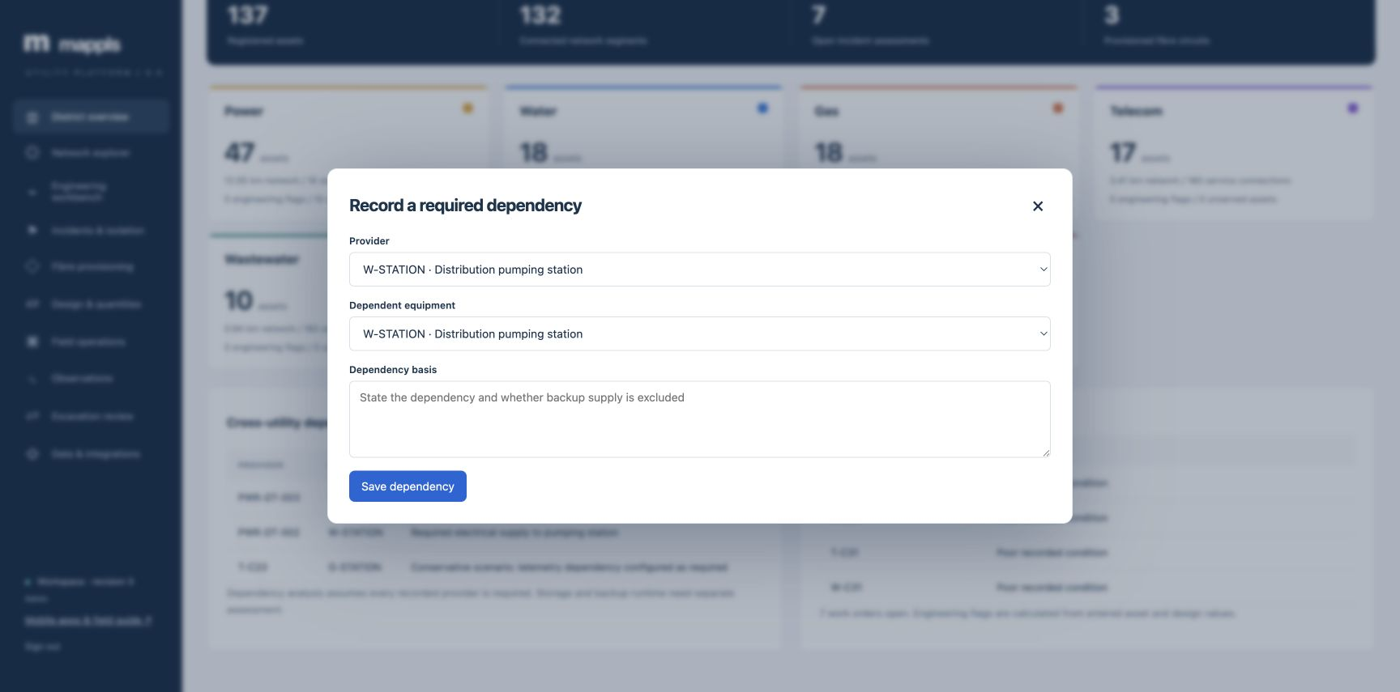
Dependency entry on screen
Choose Provider and Dependent equipment. Explain the dependency and backup assumption before saving.
Mappls Utility / Web manual / 0.5
17
Notes:
Actual local application capture on 24 September 2026. This screenshot follows the matching procedure. Choose Provider and Dependent equipment. Explain the dependency and backup assumption before saving.
1. Choose Provider and Dependent equipment. Explain the dependency and backup assumption before saving.
Source: mobile/README.md; mobile/ios/MapplsUtility/MapplsUtilityApp.swift; mobile/android/app/src/main/java/com/mappls/utility/MainActivity.java; app/static/utility.js; app/static/guidance.js; app/verticals/api.py; app/mobile.py; docs/mobile-validation.md
Companion: Mappls Utility Mobile User Manual

Slide 18
Connectivity trace
All roles, reviewed by Engineer
01
Choose the start and mode
Open Engineering workbench. Select Start equipment and source/outfall, upstream, downstream or connected mode.
02
Set supported constraints
Enter known Asset barriers and, for power, a Conductor phase. Select Run trace.
03
Review the result
Compare reached equipment, service count, length and source-found status. Use View on map and Export.
Outcome: a trace tied to the selected inputs and network revision.
Mappls Utility / Web manual / 0.5
18
Notes:
The module opens with a calculated read-only source preview. Open electrical controls and closed fluid controls interrupt traversal. Power follows recorded conductor direction. Collection networks lead toward treatment/outfalls. Other networks use recorded physical connectivity.
Source: mobile/README.md; mobile/ios/MapplsUtility/MapplsUtilityApp.swift; mobile/android/app/src/main/java/com/mappls/utility/MainActivity.java; app/static/utility.js; app/static/guidance.js; app/verticals/api.py; app/mobile.py; docs/mobile-validation.md
Companion: Mappls Utility Mobile User Manual

Slide 19
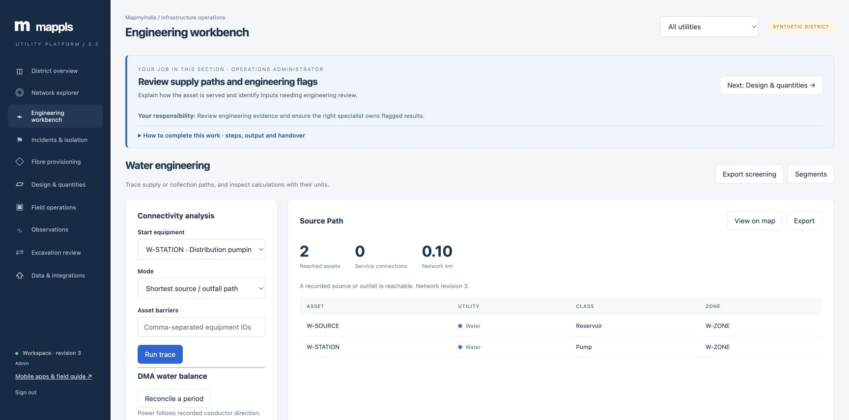
Trace inputs and result
Set Start equipment, Mode and barriers. Run trace, then review reached assets and the source-found result.
Mappls Utility / Web manual / 0.5
19
Notes:
Actual local application capture on 24 September 2026. This screenshot follows the matching procedure. Set Start equipment, Mode and barriers. Run trace, then review reached assets and the source-found result.
1. Set Start equipment, Mode and barriers. Run trace, then review reached assets and the source-found result.
Source: mobile/README.md; mobile/ios/MapplsUtility/MapplsUtilityApp.swift; mobile/android/app/src/main/java/com/mappls/utility/MainActivity.java; app/static/utility.js; app/static/guidance.js; app/verticals/api.py; app/mobile.py; docs/mobile-validation.md
Companion: Mappls Utility Mobile User Manual

Slide 20
Engineering screening and export
Engineer / Administrator
01
Select the utility
Open Engineering workbench and read the assumptions above Engineering screening.
02
Inspect flagged rows
Compare each equipment/segment metric, result, unit, review limit and status.
03
Retain the evidence
Use Export screening. Assign a data correction, design review or field observation against the relevant IDs.
Check: a screened result does not certify operational performance.
Mappls Utility / Web manual / 0.5
20
Notes:
These are simplified screening models. Use the utility-specific input assumptions in the next slides and the application result. Exported values are only as current as the network revision and recorded attributes.
Source: mobile/README.md; mobile/ios/MapplsUtility/MapplsUtilityApp.swift; mobile/android/app/src/main/java/com/mappls/utility/MainActivity.java; app/static/utility.js; app/static/guidance.js; app/verticals/api.py; app/mobile.py; docs/mobile-validation.md
Companion: Mappls Utility Mobile User Manual

Slide 21
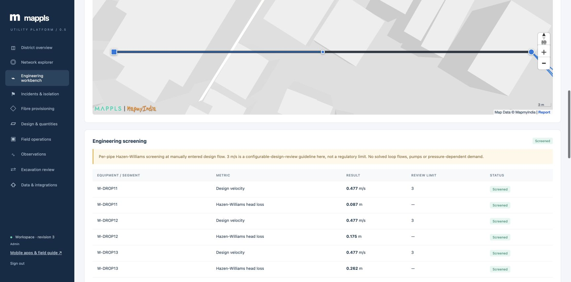
Engineering screening results
Read the metric, result, unit and review limit. Export screening from the top of the module.
Mappls Utility / Web manual / 0.5
21
Notes:
Actual local application capture on 24 September 2026. This screenshot follows the matching procedure. Read the metric, result, unit and review limit. Export screening from the top of the module.
1. Read the metric, result, unit and review limit. Export screening from the top of the module.
Source: mobile/README.md; mobile/ios/MapplsUtility/MapplsUtilityApp.swift; mobile/android/app/src/main/java/com/mappls/utility/MainActivity.java; app/static/utility.js; app/static/guidance.js; app/verticals/api.py; app/mobile.py; docs/mobile-validation.md
Companion: Mappls Utility Mobile User Manual

Slide 22
Power, water and gas inputs
Utility | Inputs to verify | Interpretation
Power | Voltage, phase, connected load, rating, state | Nameplate screening and connectivity
Water | Flow, diameter, roughness, length, head | Steady-flow screening and DMA context
Gas | Pressure units, MAOP, flow, diameter, state | Pressure/velocity screening and connectivity
Detailed load flow, protection coordination and validated network simulation remain separate engineering work.
Mappls Utility / Web manual / 0.5
22
Notes:
Detailed load flow, protection coordination and validated network simulation remain separate engineering work.
Source: docs/engineering-models.md; app/verticals/engineering.py
Companion: Mappls Utility Mobile User Manual

Slide 23
Fibre, collection and heating inputs
Utility | Inputs to verify | Interpretation
Telecom | Strands, attenuation, splices, splitters, risks | Physical capacity and optical margin
Wastewater | Invert levels, slope, section, roughness | Gravity-flow screening to receiving works
Stormwater | Catchment, rainfall, runoff, outfall | Runoff demand and drain screening
Heating | Temperatures, demand, diameter, insulation | Thermal-flow and loss screening
Check the recorded geometry and units. Field and specialist review determine operational use.
Mappls Utility / Web manual / 0.5
23
Notes:
Check the recorded geometry and units. Field and specialist review determine operational use.
Source: mobile/README.md; mobile/ios/MapplsUtility/MapplsUtilityApp.swift; mobile/android/app/src/main/java/com/mappls/utility/MainActivity.java; app/static/utility.js; app/static/guidance.js; app/verticals/api.py; app/mobile.py; docs/mobile-validation.md
Companion: Mappls Utility Mobile User Manual

Slide 24
DMA water balance
Engineer / Administrator
01
Open the period form
Select Water in Engineering workbench, then Reconcile a period under DMA water balance.
02
Enter matching-period volumes
Provide zone, period, System input, Billed consumption and Unbilled authorized volume in m³.
03
Review the balance
Select Calculate balance. Read non-revenue percentage, water loss and the explanatory note.
Example: input 1,000 m³, billed 700 m³, authorized unbilled 50 m³ gives 30% NRW and 250 m³ loss.
Mappls Utility / Web manual / 0.5
24
Notes:
All volumes must describe the same boundary and accounting period. NRW includes authorized unbilled consumption. The result does not distinguish apparent from real losses or automatically reconcile customer billing systems.
Source: mobile/README.md; mobile/ios/MapplsUtility/MapplsUtilityApp.swift; mobile/android/app/src/main/java/com/mappls/utility/MainActivity.java; app/static/utility.js; app/static/guidance.js; app/verticals/api.py; app/mobile.py; docs/mobile-validation.md
Companion: Mappls Utility Mobile User Manual

Slide 25
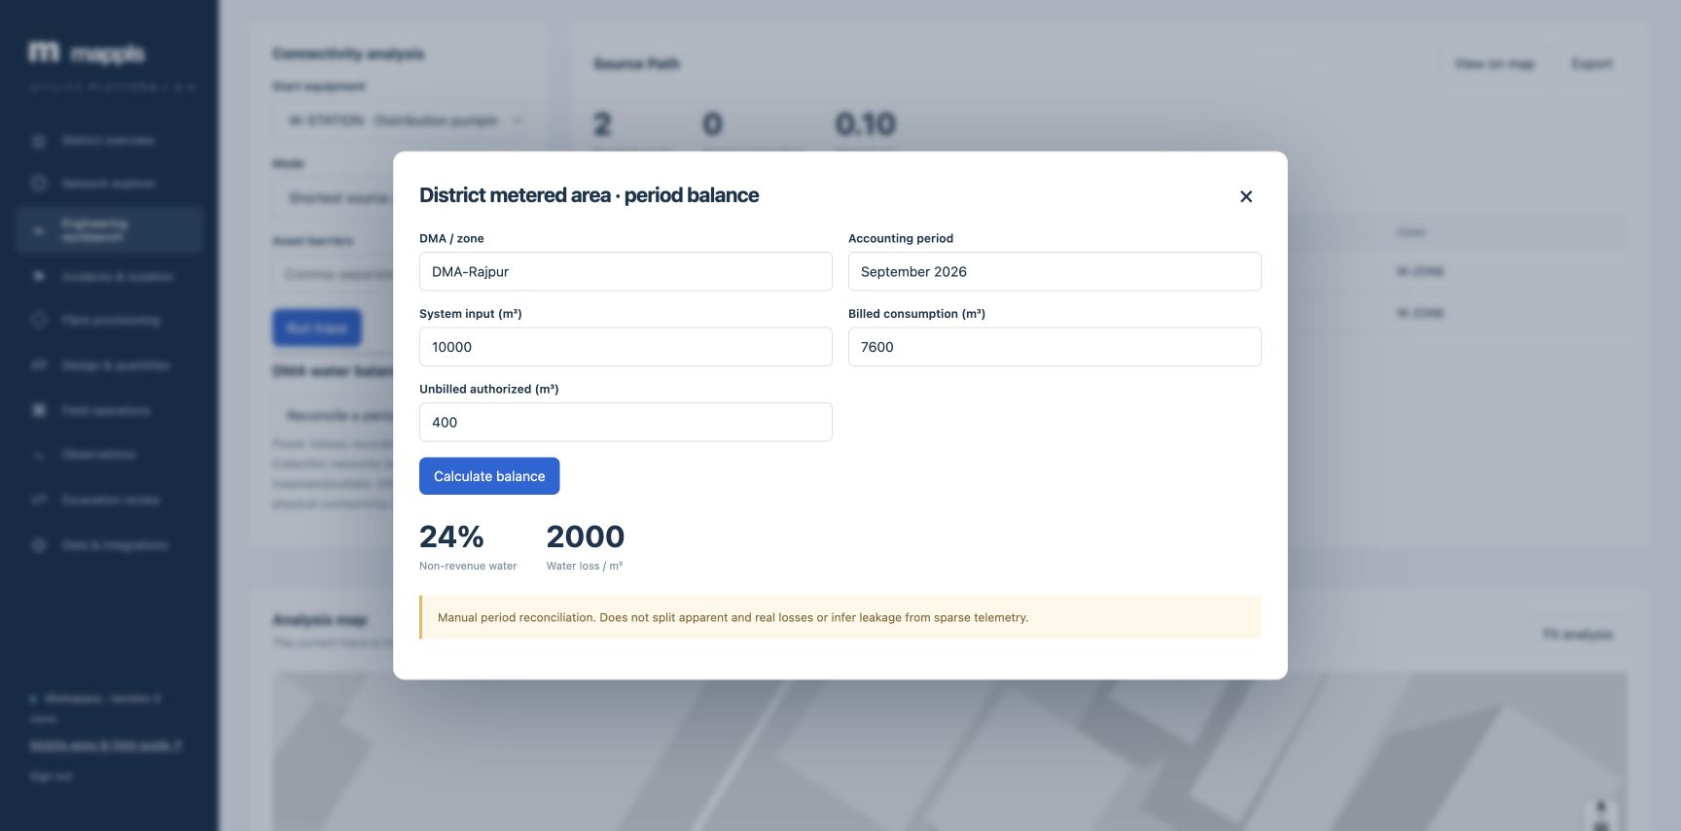
The worked DMA result
10,000 m³ input, 7,600 m³ billed and 400 m³ authorized unbilled produce 24% NRW and 2,000 m³ water loss.
Mappls Utility / Web manual / 0.5
25
Notes:
Actual local application capture on 24 September 2026. This screenshot follows the matching procedure. 10,000 m³ input, 7,600 m³ billed and 400 m³ authorized unbilled produce 24% NRW and 2,000 m³ water loss.
1. 10,000 m³ input, 7,600 m³ billed and 400 m³ authorized unbilled produce 24% NRW and 2,000 m³ water loss.
Source: mobile/README.md; mobile/ios/MapplsUtility/MapplsUtilityApp.swift; mobile/android/app/src/main/java/com/mappls/utility/MainActivity.java; app/static/utility.js; app/static/guidance.js; app/verticals/api.py; app/mobile.py; docs/mobile-validation.md
Companion: Mappls Utility Mobile User Manual

Slide 26
Failure impact and isolation assessment
Engineer / Administrator
01
Define the scenario
Open Incidents & isolation. Choose Failure target, analysis type and any additional failures.
02
Assess candidate controls
Where needed enter candidate control closures. Select Assess network and inspect impacts across utilities.
03
Prepare the handover
Review alternate paths, critical equipment and dependencies. Record an incident with a clear description.
Outcome: a documented service-impact assessment for review.
Mappls Utility / Web manual / 0.5
26
Notes:
Assessment uses recorded connectivity and dependencies. Isolation candidates are planning results. Site verification and approved operating authority remain necessary for actual isolation. Opening the module displays a read-only example assessment.
Source: mobile/README.md; mobile/ios/MapplsUtility/MapplsUtilityApp.swift; mobile/android/app/src/main/java/com/mappls/utility/MainActivity.java; app/static/utility.js; app/static/guidance.js; app/verticals/api.py; app/mobile.py; docs/mobile-validation.md
Companion: Mappls Utility Mobile User Manual

Slide 27
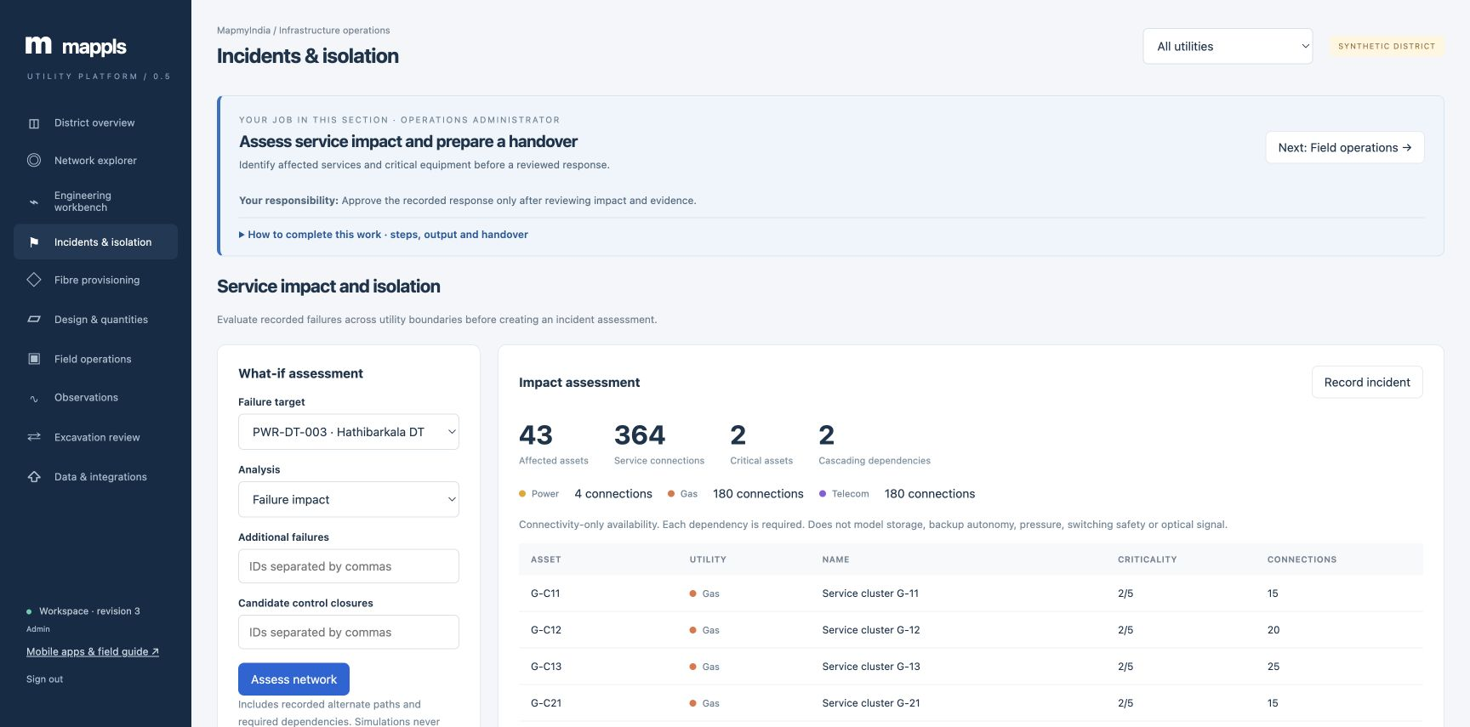
Impact assessment on screen
Choose the failure target and analysis, then Assess network. Review affected services before creating an incident.
Mappls Utility / Web manual / 0.5
27
Notes:
Actual local application capture on 24 September 2026. This screenshot follows the matching procedure. Choose the failure target and analysis, then Assess network. Review affected services before creating an incident.
1. Choose the failure target and analysis, then Assess network. Review affected services before creating an incident.
Source: mobile/README.md; mobile/ios/MapplsUtility/MapplsUtilityApp.swift; mobile/android/app/src/main/java/com/mappls/utility/MainActivity.java; app/static/utility.js; app/static/guidance.js; app/verticals/api.py; app/mobile.py; docs/mobile-validation.md
Companion: Mappls Utility Mobile User Manual

Slide 28
Incident review and closure
Engineer / Administrator
01
Assess the reported incident
Open the saved incident, record review notes and move Reported to Assessed.
02
Obtain approval
Administrator reviews the current network revision and approves. A changed topology requires reassessment.
03
Resolve and close
Record resolution evidence. Engineer/admin moves Approved to Resolved. Administrator closes the reviewed incident.
Lifecycle: Reported, Assessed, Approved, Resolved, Closed.
Mappls Utility / Web manual / 0.5
28
Notes:
An assessed incident can return to Reported for reassessment. The web transition form asks for at least 15 characters of review notes. Record the evidence and responsible decision, not only a status word.
Source: mobile/README.md; mobile/ios/MapplsUtility/MapplsUtilityApp.swift; mobile/android/app/src/main/java/com/mappls/utility/MainActivity.java; app/static/utility.js; app/static/guidance.js; app/verticals/api.py; app/mobile.py; docs/mobile-validation.md
Companion: Mappls Utility Mobile User Manual

Slide 29
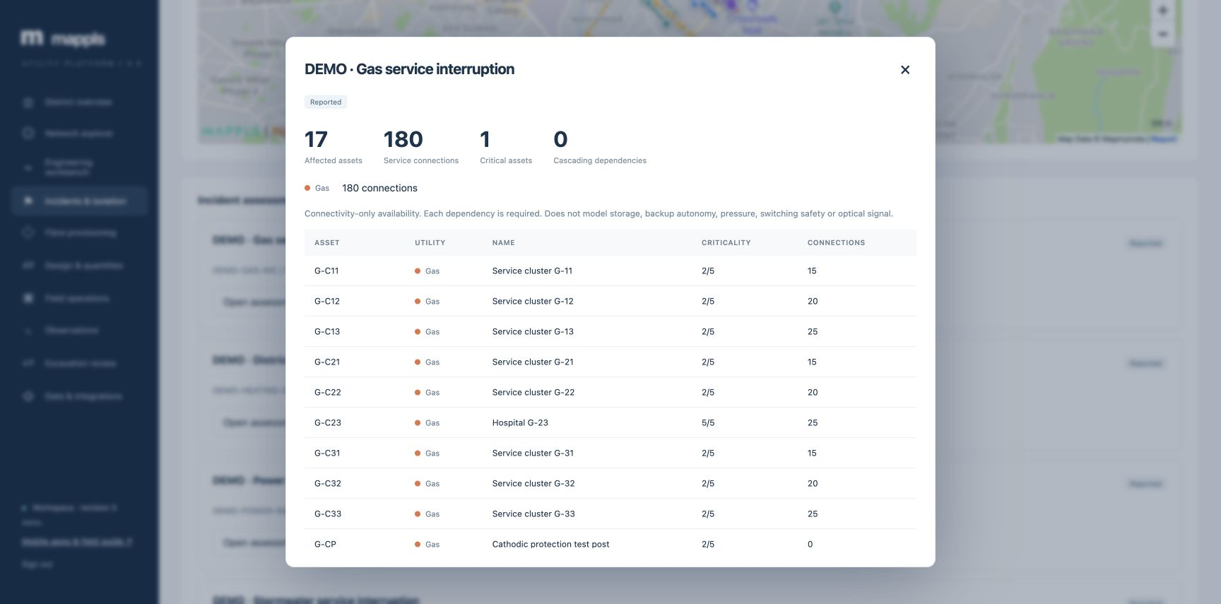
An incident assessment record
Review the impact evidence and scroll through the record to its history and next permitted lifecycle action.
Mappls Utility / Web manual / 0.5
29
Notes:
Actual local application capture on 24 September 2026. This screenshot follows the matching procedure. Review the impact evidence and scroll through the record to its history and next permitted lifecycle action.
1. Review the impact evidence and scroll through the record to its history and next permitted lifecycle action.
Source: mobile/README.md; mobile/ios/MapplsUtility/MapplsUtilityApp.swift; mobile/android/app/src/main/java/com/mappls/utility/MainActivity.java; app/static/utility.js; app/static/guidance.js; app/verticals/api.py; app/mobile.py; docs/mobile-validation.md
Companion: Mappls Utility Mobile User Manual

Slide 30
Fibre service allocation
Engineer / Administrator
01
Define the service
Open Fibre provisioning. Enter service name, source POP/OLT, endpoint and optical budget in dB.
02
Check route feasibility
Select Single route or Link and shared-risk disjoint protection, then Find feasible route.
03
Reserve after review
Inspect route, core, loss, margin and assumptions. Select Reserve circuit and confirm the service list.
Outcome: an active circuit allocation with recorded strand capacity.
Mappls Utility / Web manual / 0.5
30
Notes:
The demo network contains a shared uplink, so diverse protection may be unavailable. Atomic reservation prevents duplicate allocation of the same core. Viewer and field users may preview but cannot reserve. Release returns capacity and requires confirmed service withdrawal.
Source: mobile/README.md; mobile/ios/MapplsUtility/MapplsUtilityApp.swift; mobile/android/app/src/main/java/com/mappls/utility/MainActivity.java; app/static/utility.js; app/static/guidance.js; app/verticals/api.py; app/mobile.py; docs/mobile-validation.md
Companion: Mappls Utility Mobile User Manual

Slide 31
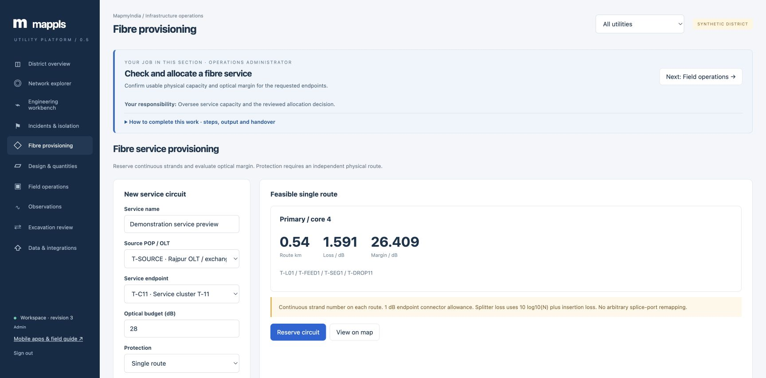
Fibre route feasibility
Find feasible route shows the proposed core, path and optical margin. Reserve circuit commits capacity after review.
Mappls Utility / Web manual / 0.5
31
Notes:
Actual local application capture on 24 September 2026. This screenshot follows the matching procedure. Find feasible route shows the proposed core, path and optical margin. Reserve circuit commits capacity after review.
1. Find feasible route shows the proposed core, path and optical margin. Reserve circuit commits capacity after review.
Source: mobile/README.md; mobile/ios/MapplsUtility/MapplsUtilityApp.swift; mobile/android/app/src/main/java/com/mappls/utility/MainActivity.java; app/static/utility.js; app/static/guidance.js; app/verticals/api.py; app/mobile.py; docs/mobile-validation.md
Companion: Mappls Utility Mobile User Manual

Slide 32
Design proposal and quantities
Engineer / Administrator
01
Create the draft
Open Design & quantities and select + Design proposal. Start with the typed extension provided.
02
Enter the proposed records
Edit Design JSON with assets, connections and material unit rates. Select Validate and save draft.
03
Review quantities
Open Review design & BOM. Check units, entered INR rates, quantities and the proposed connection.
Outcome: a saved draft distinct from the operating network.
Mappls Utility / Web manual / 0.5
32
Notes:
The current editor uses typed JSON, not a graphical CAD drawing tool. The bill of materials uses endpoint lengths and entered rates. It excludes taxes, accessories, wastage and construction tolerances. Coordinate source/target direction with the utility model.
Source: mobile/README.md; mobile/ios/MapplsUtility/MapplsUtilityApp.swift; mobile/android/app/src/main/java/com/mappls/utility/MainActivity.java; app/static/utility.js; app/static/guidance.js; app/verticals/api.py; app/mobile.py; docs/mobile-validation.md
Companion: Mappls Utility Mobile User Manual

Slide 33
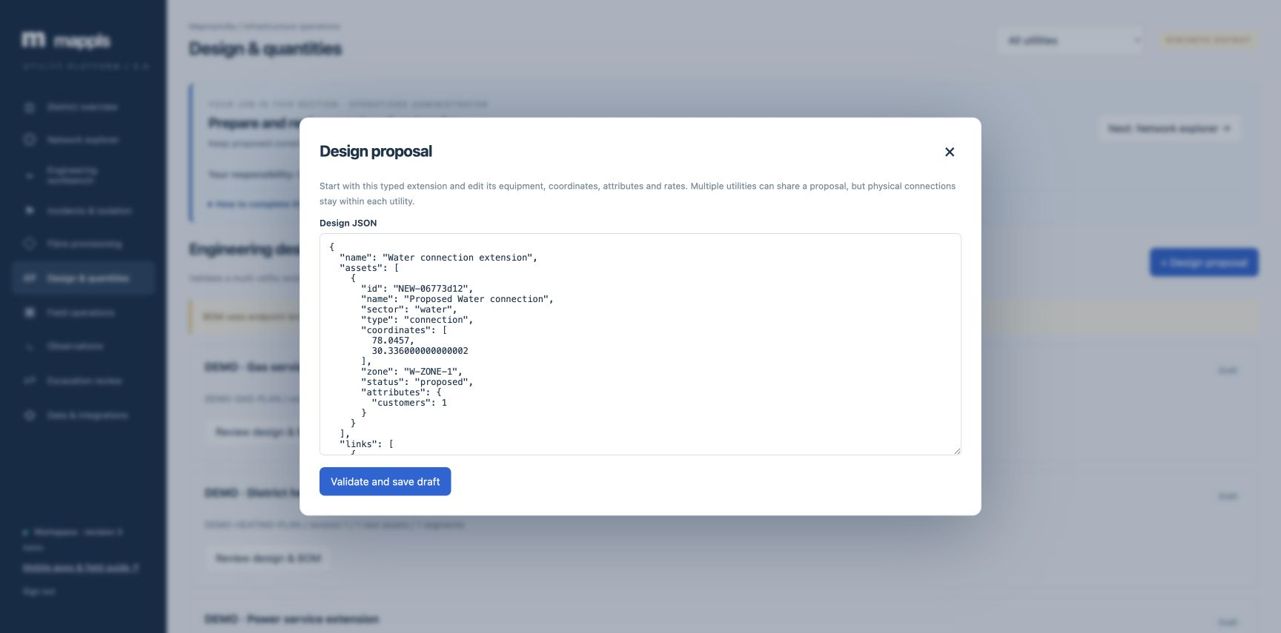
A typed design proposal
Edit equipment, endpoints, attributes and rates. Validate and save draft keeps the proposal separate from operating assets.
Mappls Utility / Web manual / 0.5
33
Notes:
Actual local application capture on 24 September 2026. This screenshot follows the matching procedure. Edit equipment, endpoints, attributes and rates. Validate and save draft keeps the proposal separate from operating assets.
1. Edit equipment, endpoints, attributes and rates. Validate and save draft keeps the proposal separate from operating assets.
Source: mobile/README.md; mobile/ios/MapplsUtility/MapplsUtilityApp.swift; mobile/android/app/src/main/java/com/mappls/utility/MainActivity.java; app/static/utility.js; app/static/guidance.js; app/verticals/api.py; app/mobile.py; docs/mobile-validation.md
Companion: Mappls Utility Mobile User Manual

Slide 34
Design approval and commissioning
Engineer, then Administrator
01
Submit a reviewed draft
Use Revise draft for corrections, export the BOM and submit the proposal for review.
02
Approve current evidence
Administrator checks the design and network revision, records review notes and approves.
03
Commission after acceptance
Administrator selects Commissioned after the organization’s construction acceptance. Verify the new register and trace.
Lifecycle: Draft, Submitted, Approved, Commissioned.
Mappls Utility / Web manual / 0.5
34
Notes:
Submitted or approved designs may return to Draft. Network changes invalidate pending approval/commissioning and require revision and resubmission. Commissioning commits the proposed records atomically. Do not use this action merely to preview a proposal.
Source: mobile/README.md; mobile/ios/MapplsUtility/MapplsUtilityApp.swift; mobile/android/app/src/main/java/com/mappls/utility/MainActivity.java; app/static/utility.js; app/static/guidance.js; app/verticals/api.py; app/mobile.py; docs/mobile-validation.md
Companion: Mappls Utility Mobile User Manual

Slide 35
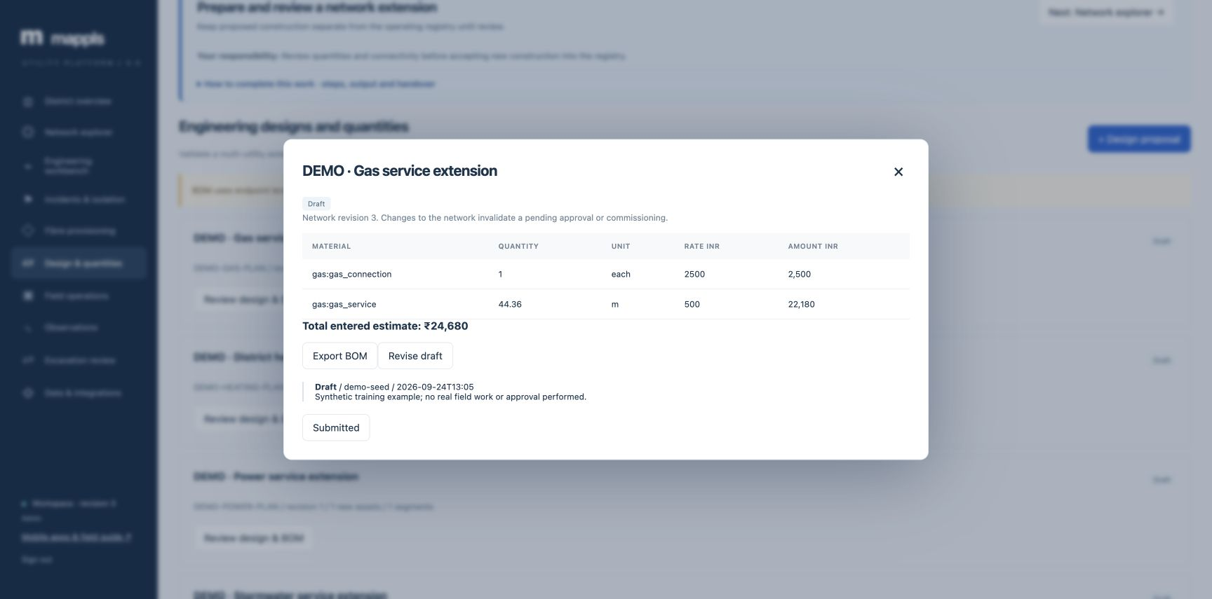
Design quantities and review
Review the BOM and current state. Submitted starts review; later approval and commissioning require the permitted role.
Mappls Utility / Web manual / 0.5
35
Notes:
Actual local application capture on 24 September 2026. This screenshot follows the matching procedure. Review the BOM and current state. Submitted starts review; later approval and commissioning require the permitted role.
1. Review the BOM and current state. Submitted starts review; later approval and commissioning require the permitted role.
Source: mobile/README.md; mobile/ios/MapplsUtility/MapplsUtilityApp.swift; mobile/android/app/src/main/java/com/mappls/utility/MainActivity.java; app/static/utility.js; app/static/guidance.js; app/verticals/api.py; app/mobile.py; docs/mobile-validation.md
Companion: Mappls Utility Mobile User Manual

Slide 36
Work assignment and mobile handover
Engineer / Administrator
01
Create the assignment
In Field operations select + Work order. Specify equipment, title, crew, due date, priority and checklist.
02
Confirm the field brief
Agree scope and evidence requirements. Ask the crew to refresh its native field pack before leaving connectivity.
03
Review accepted work
After mobile synchronization, refresh Field operations and inspect work status, findings and inspection history.
Outcome: a job with a clear owner, checklist and evidence handover.
Mappls Utility / Web manual / 0.5
36
Notes:
Native and browser inspection queues are separate. Assignment records do not enforce individual crew authorization in the shared-role pilot. Creation requires admin/engineer. Field users can execute existing work.
Source: mobile/README.md; mobile/ios/MapplsUtility/MapplsUtilityApp.swift; mobile/android/app/src/main/java/com/mappls/utility/MainActivity.java; app/static/utility.js; app/static/guidance.js; app/verticals/api.py; app/mobile.py; docs/mobile-validation.md
Companion: Mappls Utility Mobile User Manual

Slide 37
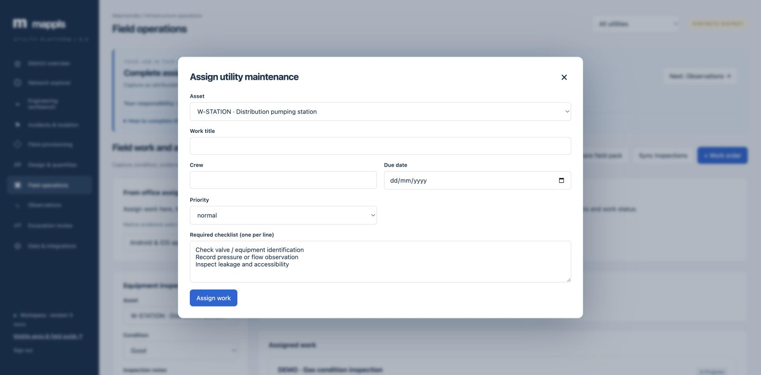
Assignment for a field crew
Set the asset, crew, date and checklist. Assign work, then have the native crew refresh its field pack.
Mappls Utility / Web manual / 0.5
37
Notes:
Actual local application capture on 24 September 2026. This screenshot follows the matching procedure. Set the asset, crew, date and checklist. Assign work, then have the native crew refresh its field pack.
1. Set the asset, crew, date and checklist. Assign work, then have the native crew refresh its field pack.
Source: mobile/README.md; mobile/ios/MapplsUtility/MapplsUtilityApp.swift; mobile/android/app/src/main/java/com/mappls/utility/MainActivity.java; app/static/utility.js; app/static/guidance.js; app/verticals/api.py; app/mobile.py; docs/mobile-validation.md
Companion: Mappls Utility Mobile User Manual

Slide 38
Browser inspection capture
Field / Engineer / Administrator
01
Prepare and select
Open Field operations, choose Prepare field pack while online, then select the inspected asset.
02
Enter the finding
Choose condition, enter notes and attach permitted GPS/photo evidence if available.
03
Queue and synchronize
Select Save to device queue, inspect Pending inspections, then Sync inspections and verify acceptance.
Check: browser inspection storage is separate from native mobile storage.
Mappls Utility / Web manual / 0.5
38
Notes:
The browser supports an offline inspection queue. Keep the same browser profile and its site data until synchronization succeeds. The native app provides additional offline work transitions/readings and encrypted storage. Browser GPS/photo permissions depend on the browser.
Source: mobile/README.md; mobile/ios/MapplsUtility/MapplsUtilityApp.swift; mobile/android/app/src/main/java/com/mappls/utility/MainActivity.java; app/static/utility.js; app/static/guidance.js; app/verticals/api.py; app/mobile.py; docs/mobile-validation.md
Companion: Mappls Utility Mobile User Manual

Slide 39
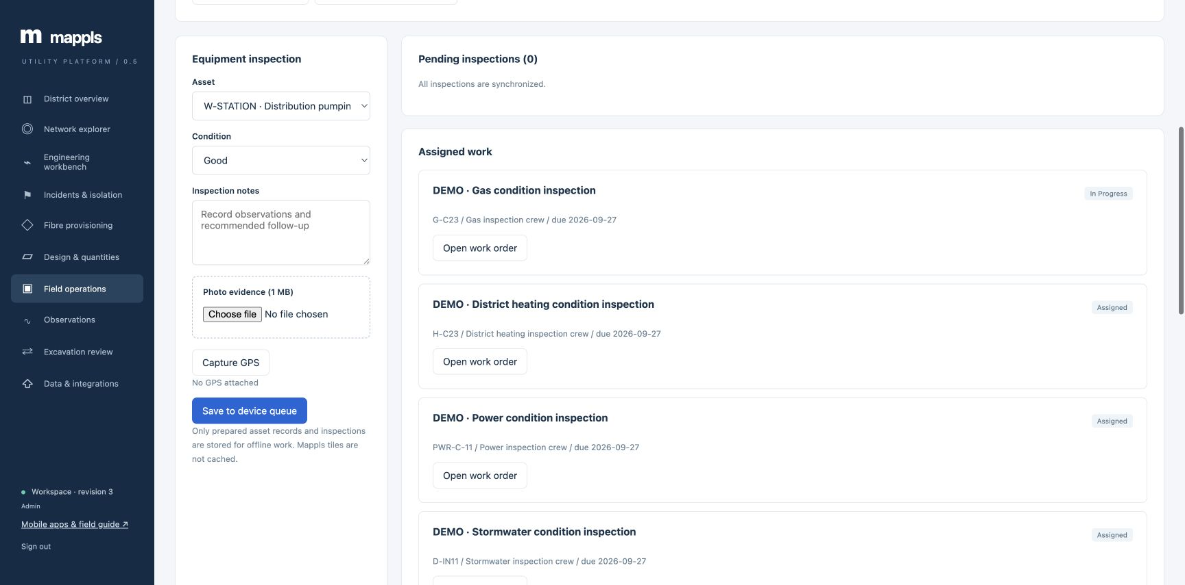
Inspection in the browser
Select the asset, record condition and notes, attach evidence and Save to device queue. Sync inspections sends the browser queue.
Mappls Utility / Web manual / 0.5
39
Notes:
Actual local application capture on 24 September 2026. This screenshot follows the matching procedure. Select the asset, record condition and notes, attach evidence and Save to device queue. Sync inspections sends the browser queue.
1. Select the asset, record condition and notes, attach evidence and Save to device queue. Sync inspections sends the browser queue.
Source: mobile/README.md; mobile/ios/MapplsUtility/MapplsUtilityApp.swift; mobile/android/app/src/main/java/com/mappls/utility/MainActivity.java; app/static/utility.js; app/static/guidance.js; app/verticals/api.py; app/mobile.py; docs/mobile-validation.md
Companion: Mappls Utility Mobile User Manual

Slide 40
Work execution in the web app
Field / Engineer / Administrator
01
Open the work order
Verify equipment, assigned crew, due date and checklist, then select Start work.
02
Record actual completion
Complete every required checklist item and add findings or completion evidence.
03
Confirm the status
Select Complete work and review the refreshed record and timeline.
Lifecycle: Assigned, In progress, Completed.
Mappls Utility / Web manual / 0.5
40
Notes:
Completion requires the full checklist and at least ten characters of evidence. The work record and inspection history are related evidence, but an inspection alone does not automatically complete a job. Use native Work for queued mobile transitions.
Source: mobile/README.md; mobile/ios/MapplsUtility/MapplsUtilityApp.swift; mobile/android/app/src/main/java/com/mappls/utility/MainActivity.java; app/static/utility.js; app/static/guidance.js; app/verticals/api.py; app/mobile.py; docs/mobile-validation.md
Companion: Mappls Utility Mobile User Manual

Slide 41
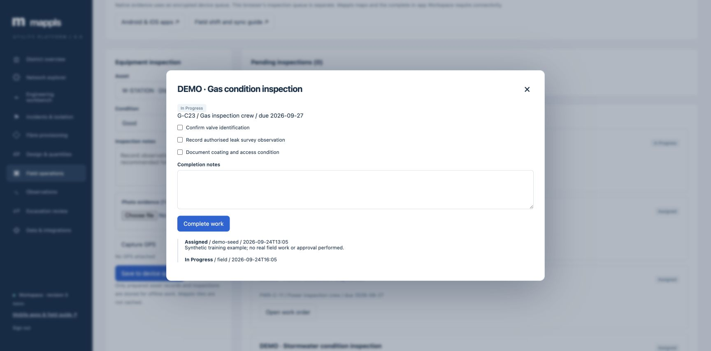
The web completion form
Complete the required checks and notes before Complete work. This example is already In Progress.
Mappls Utility / Web manual / 0.5
41
Notes:
Actual local application capture on 24 September 2026. This screenshot follows the matching procedure. Complete the required checks and notes before Complete work. This example is already In Progress.
1. Complete the required checks and notes before Complete work. This example is already In Progress.
Source: mobile/README.md; mobile/ios/MapplsUtility/MapplsUtilityApp.swift; mobile/android/app/src/main/java/com/mappls/utility/MainActivity.java; app/static/utility.js; app/static/guidance.js; app/verticals/api.py; app/mobile.py; docs/mobile-validation.md
Companion: Mappls Utility Mobile User Manual

Slide 42
Observation entry and review
Field / Engineer / Administrator
01
Choose equipment and metric
Open Observations. Select the asset and an allowed measurement. Read the unit beside Value.
02
Provide measurement context
Enter value, observation time and instrument/method notes. Select Save observation.
03
Review the register
Check asset, value, unit, time and Review flag. Route exceptions to the engineer through the agreed process.
Outcome: a timestamped manual observation linked to an asset.
Mappls Utility / Web manual / 0.5
42
Notes:
The form is not a live telemetry feed. Gas concentration, pressure above recorded MAOP and low water head can generate review flags. A flag is a prompt for review, not operational clearance or an automatic emergency notification.
Source: mobile/README.md; mobile/ios/MapplsUtility/MapplsUtilityApp.swift; mobile/android/app/src/main/java/com/mappls/utility/MainActivity.java; app/static/utility.js; app/static/guidance.js; app/verticals/api.py; app/mobile.py; docs/mobile-validation.md
Companion: Mappls Utility Mobile User Manual

Slide 43
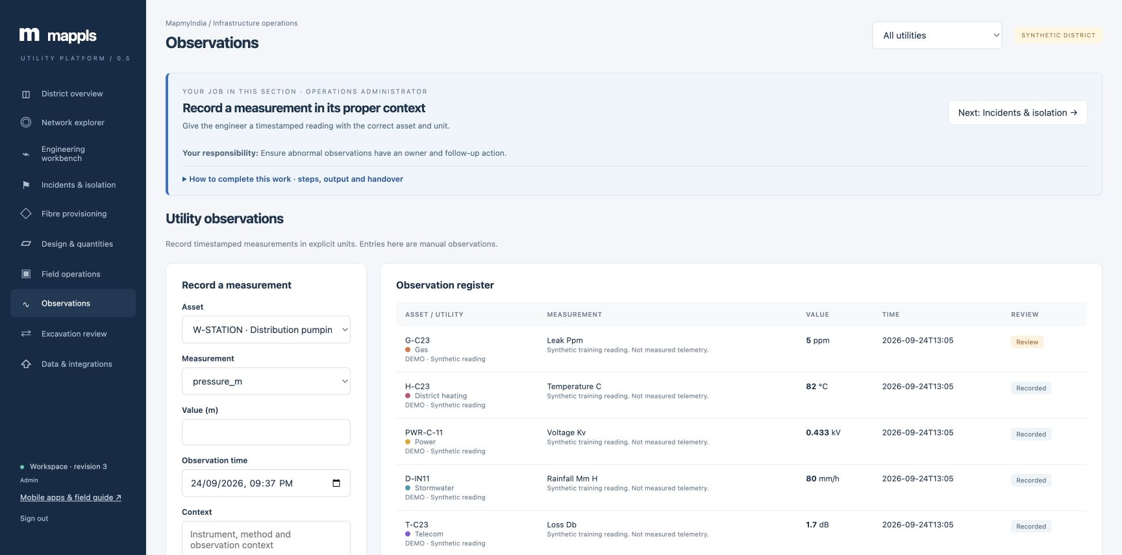
Measurements and the observation register
Select the asset and metric. Use its displayed unit, observation time and instrument context before saving.
Mappls Utility / Web manual / 0.5
43
Notes:
Actual local application capture on 24 September 2026. This screenshot follows the matching procedure. Select the asset and metric. Use its displayed unit, observation time and instrument context before saving.
1. Select the asset and metric. Use its displayed unit, observation time and instrument context before saving.
Source: mobile/README.md; mobile/ios/MapplsUtility/MapplsUtilityApp.swift; mobile/android/app/src/main/java/com/mappls/utility/MainActivity.java; app/static/utility.js; app/static/guidance.js; app/verticals/api.py; app/mobile.py; docs/mobile-validation.md
Companion: Mappls Utility Mobile User Manual

Slide 44
Observation units
Utility | Measurements | Review context
Power | kV / A / kWh | Phase, equipment rating and instrument
Water / Gas | m, m³, mg/L / bar(g), ppm, mV | DMA/sample / MAOP and leak context
Telecom | dBm / dB / ms | Endpoints and test setup
Wastewater / Stormwater | m, L/s / mm/h, m | Collection point and catchment
Heating | °C / kWh | Supply/return and accounting period
Choose the exact metric offered for the selected equipment. Input bounds are not safe operating limits.
Mappls Utility / Web manual / 0.5
44
Notes:
Choose the exact metric offered for the selected equipment. Input bounds are not safe operating limits.
Source: mobile/README.md; mobile/ios/MapplsUtility/MapplsUtilityApp.swift; mobile/android/app/src/main/java/com/mappls/utility/MainActivity.java; app/static/utility.js; app/static/guidance.js; app/verticals/api.py; app/mobile.py; docs/mobile-validation.md
Companion: Mappls Utility Mobile User Manual

Slide 45
Corridor screening and review
Engineer / Administrator
01
Define the corridor
Open Excavation review. Enter title, start/end locations, search buffer in m and excavation depth in m.
02
Check findings
Select Check corridor. Inspect nearby assets, crossing segments, distance, recorded depth and nominal separation.
03
Save the evidence
Select Save review. Record survey/owner evidence in review notes and progress the internal review.
Lifecycle: Draft, Reviewed, Approved, Closed. Admin controls approval and closure.
Mappls Utility / Web manual / 0.5
45
Notes:
The selected endpoints form the assessed alignment. Unknown or nominal depths require independent confirmation. Internal review does not issue a statutory dig permit. A changed network revision requires reassessment before review/approval.
Source: mobile/README.md; mobile/ios/MapplsUtility/MapplsUtilityApp.swift; mobile/android/app/src/main/java/com/mappls/utility/MainActivity.java; app/static/utility.js; app/static/guidance.js; app/verticals/api.py; app/mobile.py; docs/mobile-validation.md
Companion: Mappls Utility Mobile User Manual

Slide 46
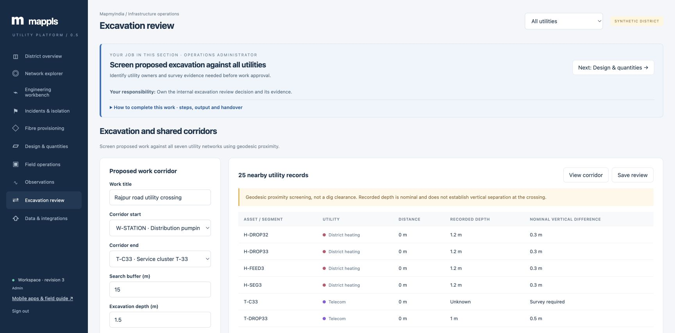
Corridor screening result
Set the endpoints, buffer and excavation depth. Review crossings and nearby utilities before Save review.
Mappls Utility / Web manual / 0.5
46
Notes:
Actual local application capture on 24 September 2026. This screenshot follows the matching procedure. Set the endpoints, buffer and excavation depth. Review crossings and nearby utilities before Save review.
1. Set the endpoints, buffer and excavation depth. Review crossings and nearby utilities before Save review.
Source: mobile/README.md; mobile/ios/MapplsUtility/MapplsUtilityApp.swift; mobile/android/app/src/main/java/com/mappls/utility/MainActivity.java; app/static/utility.js; app/static/guidance.js; app/verticals/api.py; app/mobile.py; docs/mobile-validation.md
Companion: Mappls Utility Mobile User Manual

Slide 47
Typed GeoJSON import
Engineer / Administrator
01
Prepare the source
Open Data & integrations. Export the current baseline. Load a GeoJSON file or use Example as the schema starting point.
02
Validate first
Check WGS84 coordinates, asset IDs, sector/types and connection source/target IDs. Select Validate and resolve errors.
03
Commit and reconcile
Select Commit batch only after validation succeeds. Compare counts, map positions and representative traces.
Outcome: a committed typed batch or a clear data-quality error list.
Mappls Utility / Web manual / 0.5
47
Notes:
Points represent equipment. Segments use two endpoints and explicit references. The batch commits in one transaction. Retain source file/version and reviewer identity outside the shared-role record as required by the organization. Validation is not proof of survey accuracy.
Source: mobile/README.md; mobile/ios/MapplsUtility/MapplsUtilityApp.swift; mobile/android/app/src/main/java/com/mappls/utility/MainActivity.java; app/static/utility.js; app/static/guidance.js; app/verticals/api.py; app/mobile.py; docs/mobile-validation.md
Companion: Mappls Utility Mobile User Manual

Slide 48
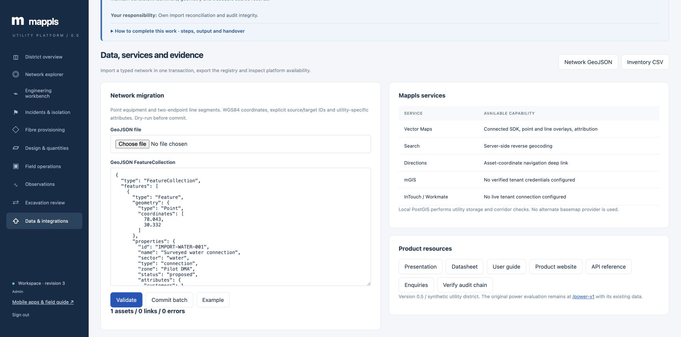
A successful import dry run
Example fills a valid FeatureCollection. Validate reports counts and errors; Commit batch becomes available after validation.
Mappls Utility / Web manual / 0.5
48
Notes:
Actual local application capture on 24 September 2026. This screenshot follows the matching procedure. Example fills a valid FeatureCollection. Validate reports counts and errors; Commit batch becomes available after validation.
1. Example fills a valid FeatureCollection. Validate reports counts and errors; Commit batch becomes available after validation.
Source: mobile/README.md; mobile/ios/MapplsUtility/MapplsUtilityApp.swift; mobile/android/app/src/main/java/com/mappls/utility/MainActivity.java; app/static/utility.js; app/static/guidance.js; app/verticals/api.py; app/mobile.py; docs/mobile-validation.md
Companion: Mappls Utility Mobile User Manual

Slide 49
Exports and audit evidence
All roles / Administrator for audit
01
Choose the appropriate export
Use Network GeoJSON or Inventory CSV in Data & integrations, Export screening, trace Export or Export BOM.
02
Record the review context
Retain utility, input assumptions, IDs, revision, time and the person responsible for the review.
03
Verify the change trail
Administrator selects Verify audit chain. Investigate unexplained failures before relying on the change history.
Outcome: evidence that can be reconciled to a known network state.
Mappls Utility / Web manual / 0.5
49
Notes:
Audit verification checks the stored chain. It does not establish that a physical inspection occurred or that all upstream source data is correct. Available exports are data outputs, not a replacement for database backup and recovery.
Source: mobile/README.md; mobile/ios/MapplsUtility/MapplsUtilityApp.swift; mobile/android/app/src/main/java/com/mappls/utility/MainActivity.java; app/static/utility.js; app/static/guidance.js; app/verticals/api.py; app/mobile.py; docs/mobile-validation.md
Companion: Mappls Utility Mobile User Manual

Slide 50
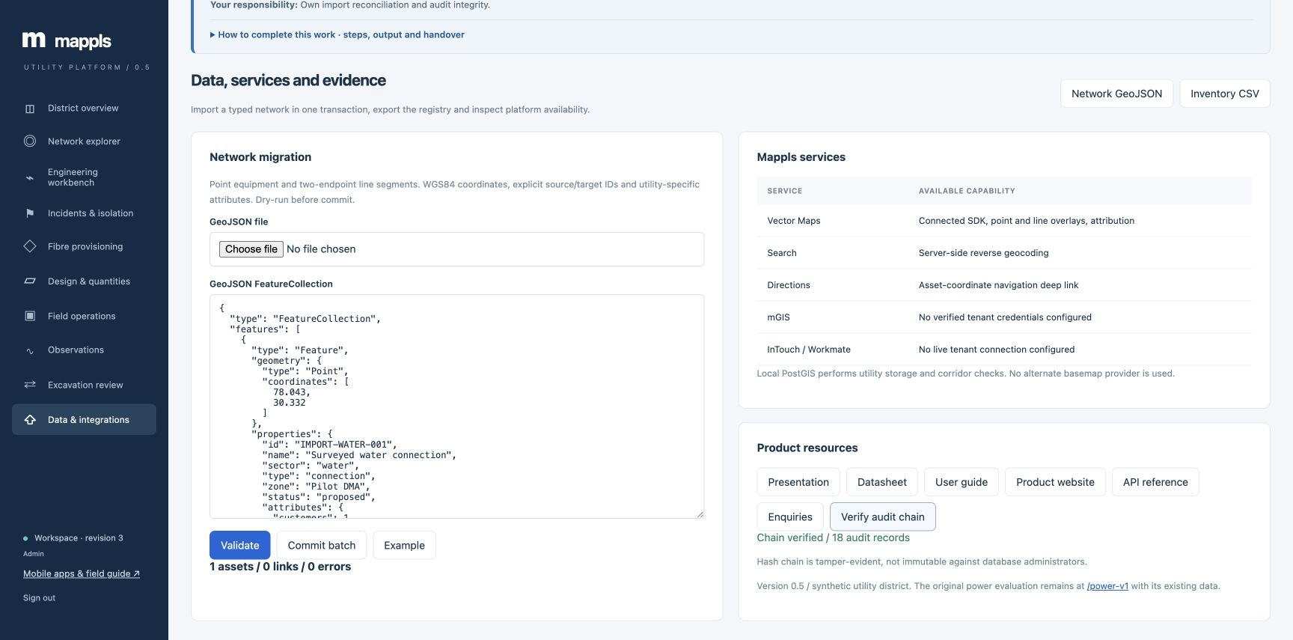
Export and audit controls
Network GeoJSON and Inventory CSV export the registry. Verify audit chain reports the recorded audit-chain result.
Mappls Utility / Web manual / 0.5
50
Notes:
Actual local application capture on 24 September 2026. This screenshot follows the matching procedure. Network GeoJSON and Inventory CSV export the registry. Verify audit chain reports the recorded audit-chain result.
1. Network GeoJSON and Inventory CSV export the registry. Verify audit chain reports the recorded audit-chain result.
Source: mobile/README.md; mobile/ios/MapplsUtility/MapplsUtilityApp.swift; mobile/android/app/src/main/java/com/mappls/utility/MainActivity.java; app/static/utility.js; app/static/guidance.js; app/verticals/api.py; app/mobile.py; docs/mobile-validation.md
Companion: Mappls Utility Mobile User Manual

Slide 51
Administrator enquiry inbox
Administrator
01
Open the inbox
In Data & integrations select Enquiries to view product enquiries received through the public site.
02
Review and record follow-up
Open the relevant record and enter a follow-up note with the appropriate status.
03
Retain ownership
Use New, Contacted, Qualified or Closed to describe the enquiry stage and coordinate the next action.
Check: updating an enquiry records a note. It does not automatically send an email.
Mappls Utility / Web manual / 0.5
51
Notes:
The enquiry inbox is separate from utility incidents. The public form obtains contact consent. Use authorized communication channels for actual follow-up and preserve enquiry privacy.
Source: mobile/README.md; mobile/ios/MapplsUtility/MapplsUtilityApp.swift; mobile/android/app/src/main/java/com/mappls/utility/MainActivity.java; app/static/utility.js; app/static/guidance.js; app/verticals/api.py; app/mobile.py; docs/mobile-validation.md
Companion: Mappls Utility Mobile User Manual

Slide 52
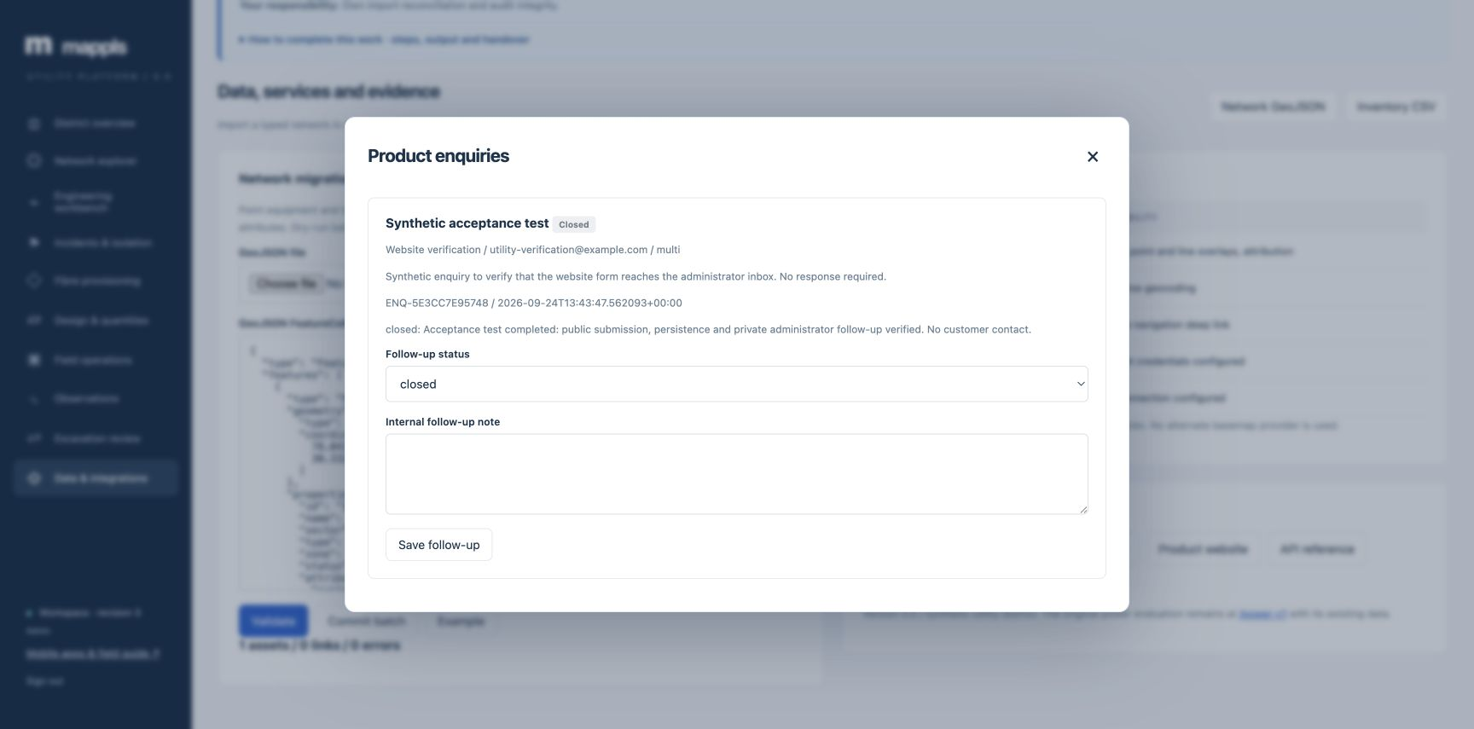
Enquiry follow-up on screen
Choose follow-up status, enter the internal note and Save follow-up. This synthetic enquiry requires no customer response.
Mappls Utility / Web manual / 0.5
52
Notes:
Actual local application capture on 24 September 2026. This screenshot follows the matching procedure. Choose follow-up status, enter the internal note and Save follow-up. This synthetic enquiry requires no customer response.
1. Choose follow-up status, enter the internal note and Save follow-up. This synthetic enquiry requires no customer response.
Source: mobile/README.md; mobile/ios/MapplsUtility/MapplsUtilityApp.swift; mobile/android/app/src/main/java/com/mappls/utility/MainActivity.java; app/static/utility.js; app/static/guidance.js; app/verticals/api.py; app/mobile.py; docs/mobile-validation.md
Companion: Mappls Utility Mobile User Manual

Slide 53
Maps, empty states and recovery
All roles
01
Distinguish missing data
Check the utility filter, asset count and search. Clear filters and confirm the expected records exist.
02
Recover a map connection
If the Mappls connection is unavailable, use Reload map connection and check internet access.
03
Review the analysis separately
Use the result table and source-found status. Check topology, lifecycle, barriers and control states when a trace is empty.
Outcome: a data issue, input issue or map connection issue assigned to the right owner.
Mappls Utility / Web manual / 0.5
53
Notes:
The application retains a shared map instance across modules and utilities. A map failure does not imply an empty register. No alternate basemap provider is substituted. Escalate persistent failures with module, utility, asset ID and time.
Source: mobile/README.md; mobile/ios/MapplsUtility/MapplsUtilityApp.swift; mobile/android/app/src/main/java/com/mappls/utility/MainActivity.java; app/static/utility.js; app/static/guidance.js; app/verticals/api.py; app/mobile.py; docs/mobile-validation.md
Companion: Mappls Utility Mobile User Manual

Slide 54
Checking map data and selection
Compare the asset count and utility filter with the selected record. A connection failure offers Reload map connection.
Mappls Utility / Web manual / 0.5
54
Notes:
Actual local application capture on 24 September 2026. This screenshot follows the matching procedure. Compare the asset count and utility filter with the selected record. A connection failure offers Reload map connection.
1. Compare the asset count and utility filter with the selected record. A connection failure offers Reload map connection.
Source: mobile/README.md; mobile/ios/MapplsUtility/MapplsUtilityApp.swift; mobile/android/app/src/main/java/com/mappls/utility/MainActivity.java; app/static/utility.js; app/static/guidance.js; app/verticals/api.py; app/mobile.py; docs/mobile-validation.md
Companion: Mappls Utility Mobile User Manual

Slide 55
Revisions, permissions and retries
All roles
01
Changed record
Reopen and compare the current record. Repeat the assessment or revise the draft against the new revision.
02
Action unavailable
Confirm your role. Ask the responsible engineer or administrator to perform restricted changes.
03
Session or connection failure
Sign in again or reconnect. Retain pending browser/native evidence until acceptance is confirmed.
Check: a retry should preserve the intended record and avoid duplicate manual entry.
Mappls Utility / Web manual / 0.5
55
Notes:
Do not clear browser data or uninstall a native app to resolve a sync issue while evidence remains unsent. Errors should be reported without passwords. Shared role accounts do not identify individual operators.
Source: mobile/README.md; mobile/ios/MapplsUtility/MapplsUtilityApp.swift; mobile/android/app/src/main/java/com/mappls/utility/MainActivity.java; app/static/utility.js; app/static/guidance.js; app/verticals/api.py; app/mobile.py; docs/mobile-validation.md
Companion: Mappls Utility Mobile User Manual

Slide 56
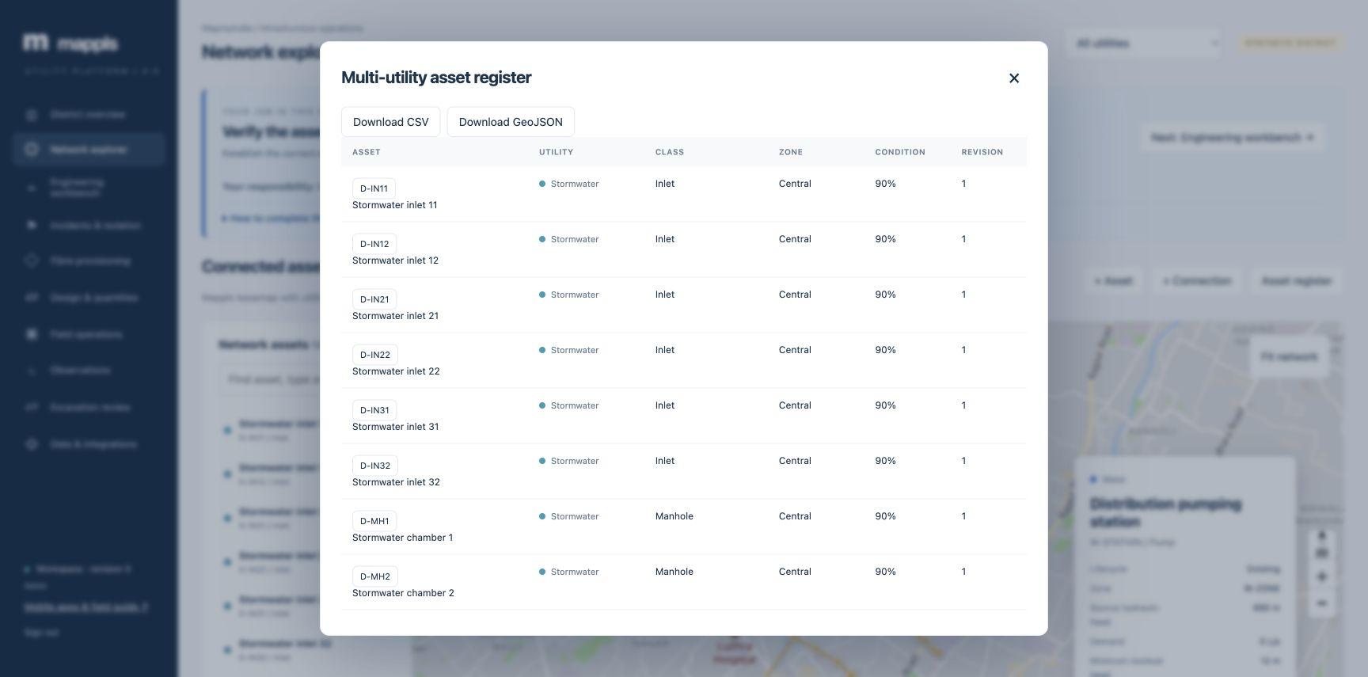
Checking record versions
Use the asset register to verify the current record and revision before revising a stale form.
Mappls Utility / Web manual / 0.5
56
Notes:
Actual local application capture on 24 September 2026. This screenshot follows the matching procedure. Use the asset register to verify the current record and revision before revising a stale form.
1. Use the asset register to verify the current record and revision before revising a stale form.
Source: mobile/README.md; mobile/ios/MapplsUtility/MapplsUtilityApp.swift; mobile/android/app/src/main/java/com/mappls/utility/MainActivity.java; app/static/utility.js; app/static/guidance.js; app/verticals/api.py; app/mobile.py; docs/mobile-validation.md
Companion: Mappls Utility Mobile User Manual

Slide 57
Worked exercise: network investigation
Viewer or Engineer
01
Locate the example
Select Power and find PWR-C-11 in Network explorer. Check its identity and attributes.
02
Trace its source
Open Engineering workbench, choose Shortest source / outfall path and Run trace.
03
Review and export
Check reached assets, source-found status and network revision. Export the trace and identify any data question.
Pass: the review cites the selected ID, path, revision and an appropriate next action.
Mappls Utility / Web manual / 0.5
57
Notes:
The seeded district is synthetic and may have changed during other evaluations. If that ID is unavailable, use another existing consumer and record the substitution. This exercise can remain read-only.
Source: mobile/README.md; mobile/ios/MapplsUtility/MapplsUtilityApp.swift; mobile/android/app/src/main/java/com/mappls/utility/MainActivity.java; app/static/utility.js; app/static/guidance.js; app/verticals/api.py; app/mobile.py; docs/mobile-validation.md
Companion: Mappls Utility Mobile User Manual

Slide 58
Worked exercise: office-to-field handover
Engineer, Field and Administrator
01
Assign a training job
Engineer creates a clearly named training work order with a specific asset and checklist.
02
Execute in the native app
Field refreshes the pack, queues/syncs start, captures TRAINING ONLY evidence and queues/syncs completion.
03
Review in the web app
Engineer refreshes Field operations and checks status, checklist and accepted evidence. Admin resolves any governance question.
Pass: the same work and asset IDs connect the office assignment with accepted field evidence.
Mappls Utility / Web manual / 0.5
58
Notes:
Coordinate training mutations with other evaluators. Record simulated activity explicitly, with no claim of real site work. This exercise validates the software handover and does not certify physical-device GPS/camera performance.
Source: mobile/README.md; mobile/ios/MapplsUtility/MapplsUtilityApp.swift; mobile/android/app/src/main/java/com/mappls/utility/MainActivity.java; app/static/utility.js; app/static/guidance.js; app/verticals/api.py; app/mobile.py; docs/mobile-validation.md
Companion: Mappls Utility Mobile User Manual

Slide 59
Worked exercise: a reviewed extension
Engineer and Administrator
01
Prepare a training draft
Choose the utility, create a clearly labelled proposal and inspect typed assets, segments and entered rates.
02
Review the quantities
Export the BOM, correct the draft and submit with a clear review basis.
03
Discuss the approval gate
Administrator checks current revision and acceptance evidence. Commission only when the training owner intends to change the registry.
Pass: the team distinguishes draft, approved proposal and commissioned operating records.
Mappls Utility / Web manual / 0.5
59
Notes:
A walkthrough may stop at review to avoid altering the shared demonstration network. The software enforces approval roles, while the organization supplies construction acceptance criteria and individual accountability.
Source: mobile/README.md; mobile/ios/MapplsUtility/MapplsUtilityApp.swift; mobile/android/app/src/main/java/com/mappls/utility/MainActivity.java; app/static/utility.js; app/static/guidance.js; app/verticals/api.py; app/mobile.py; docs/mobile-validation.md
Companion: Mappls Utility Mobile User Manual

Slide 60
Daily role checklists
All roles
01
Field and Engineer
Field checks assignments and unsent evidence. Engineer reviews abnormal observations, topology issues and proposed changes.
02
Administrator
Check outstanding approvals, evidence quality, accountable owners and unresolved data or audit issues.
03
Viewer
Review progress and exports. Send discrepancies with record IDs and context to the responsible owner.
Handover: asset/work ID, revision, finding, evidence, next owner and due date.
Mappls Utility / Web manual / 0.5
60
Notes:
Use the role-specific inline guide in each module and the mobile manual for native field work. The expected output should be understandable to the person receiving it without access to the original conversation.
Source: mobile/README.md; mobile/ios/MapplsUtility/MapplsUtilityApp.swift; mobile/android/app/src/main/java/com/mappls/utility/MainActivity.java; app/static/utility.js; app/static/guidance.js; app/verticals/api.py; app/mobile.py; docs/mobile-validation.md
Companion: Mappls Utility Mobile User Manual

Slide 61
Pilot boundaries and support
All roles
01
Implemented in this release
Seven utility registries, ten web modules, guided roles and native field capture with explicit synchronization.
02
Deployment and integration checks
Live cloud/domain, mGIS tenant access, InTouch/Workmate and production device distribution need separate verification.
03
Support information
Report role, release, module, utility, record ID, time, action and error. Preserve unsent evidence and omit passwords.
Resources: /guide for operating instructions and /mobile for native app availability.
Mappls Utility / Web manual / 0.5
61
Notes:
Engineering screening does not replace certified simulation or approved safe-work procedures. The deployment uses synthetic demonstration data. Production readiness also requires identity, scale, recovery and organization-specific acceptance work.
Source: mobile/README.md; mobile/ios/MapplsUtility/MapplsUtilityApp.swift; mobile/android/app/src/main/java/com/mappls/utility/MainActivity.java; app/static/utility.js; app/static/guidance.js; app/verticals/api.py; app/mobile.py; docs/mobile-validation.md
Companion: Mappls Utility Mobile User Manual

